Slide 1
Monday, 3/7/212
Any Questions?
Exam 1, Current Grades
Project 3
No Class on Monday, 3/14/22 (Spring Break)
Module Topics
Trees & BSTs, Module 14 (Ch. 24, 25 & 26)
Balanced Search Trees, Module 15 (Ch. 28)

Slide 2
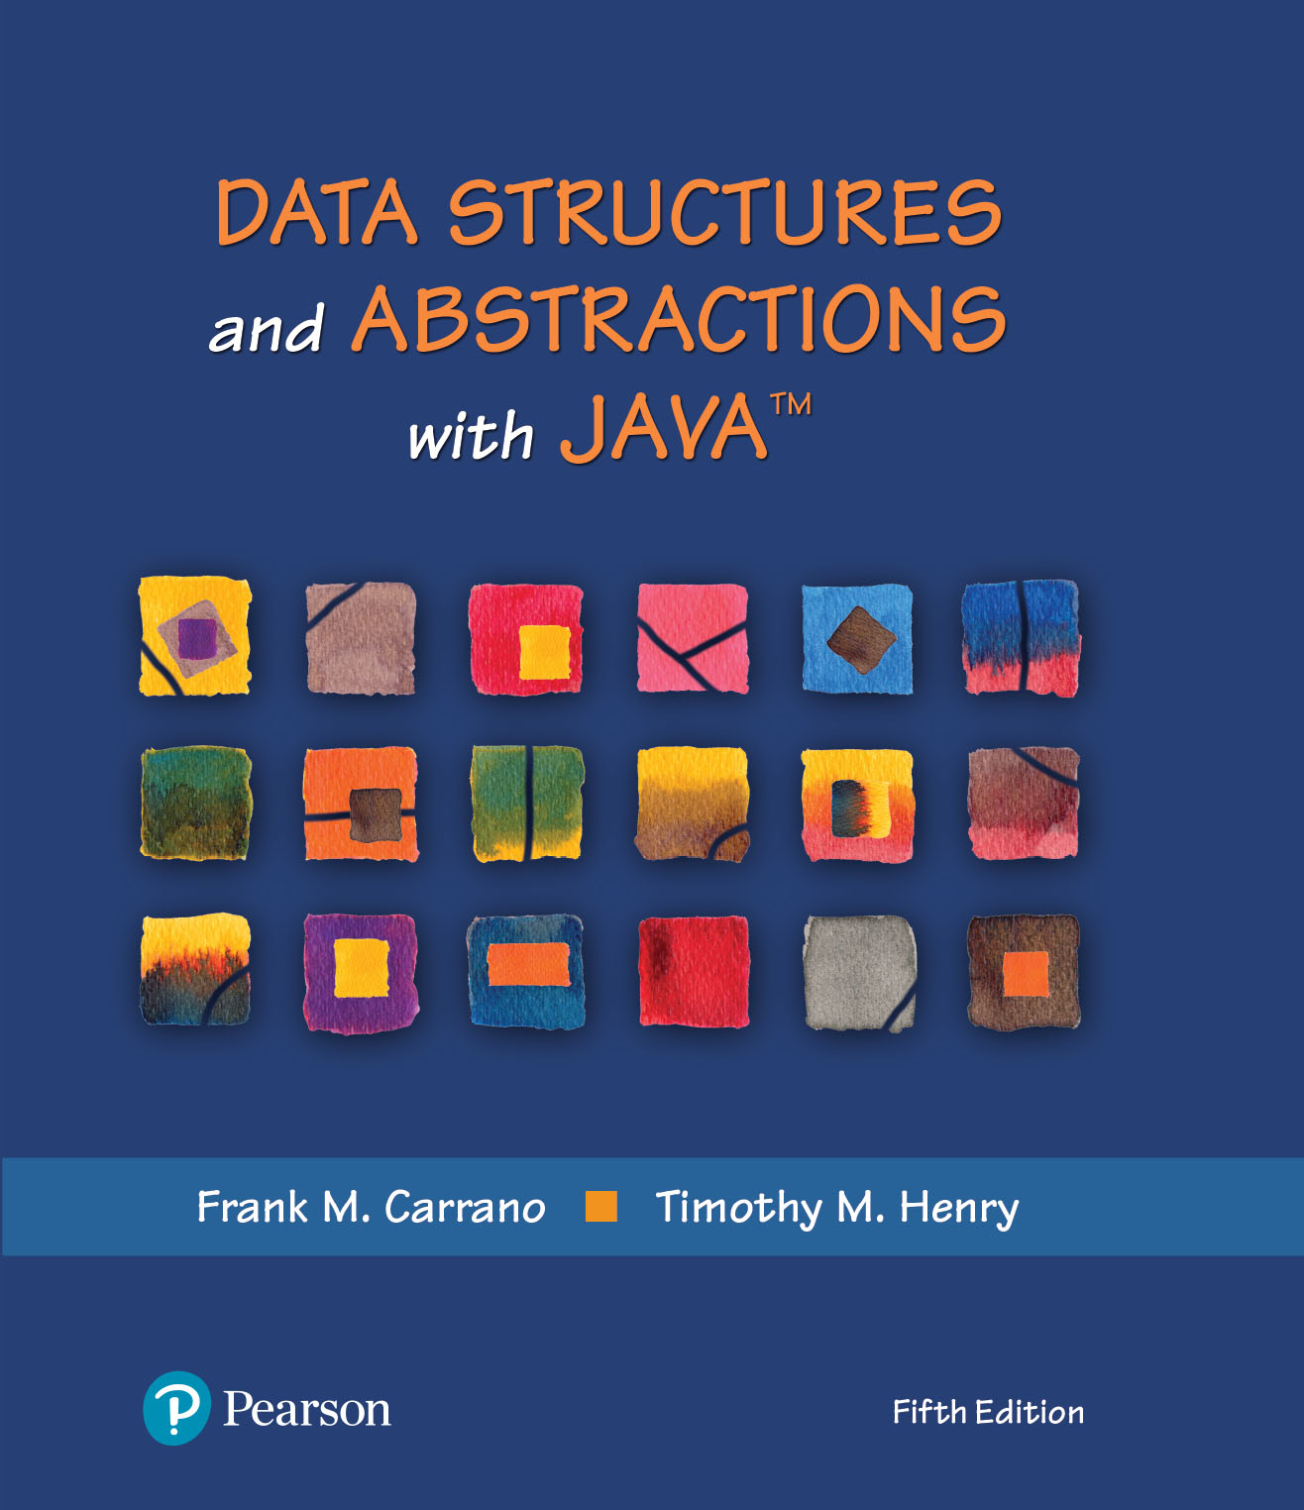
Module 14 - Trees
Ch. 24 – Trees
Ch. 25 – Tree Implementation
Ch. 26 – BST Implementation
Notes:
Q: Have you been introduced to the tree data structure?

Slide 3
Video Notes
ADT Tree
https://mediaplayer.pearsoncmg.com/assets/secs-vn-ch24a-the-adt-tree
Using the ADT Tree
https://mediaplayer.pearsoncmg.com/assets/secs-vn-ch24b-using-the-adt-tree
Creating a Binary Tree
https://mediaplayer.pearsoncmg.com/assets/secs-vn-ch25a-creating-a-binary-tree
Binary Tree Operations
https://mediaplayer.pearsoncmg.com/assets/secs-vn-ch25b-binary-tree-operations
Creating a Binary Search Tree
https://mediaplayer.pearsoncmg.com/assets/secs-vn-ch26a-creating-a-binary-search-tree
Adding & Removing in a BST
https://mediaplayer.pearsoncmg.com/assets/secs-vn-ch26b-adding-and-removing-in-a-bst
Notes:
Watch Creating a Binary Tree (twice)

Slide 4
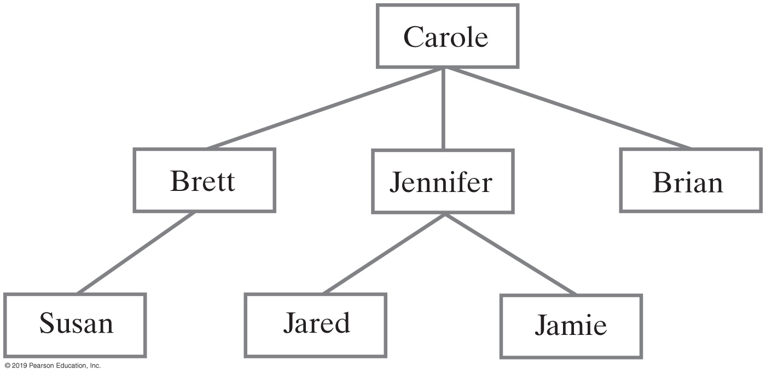
Hierarchical Organizations (1 of 2)
Carole’s children and grandchildren
Notes:
ADTs: Bag, Stack, Queue, List. Dictionary

Slide 5
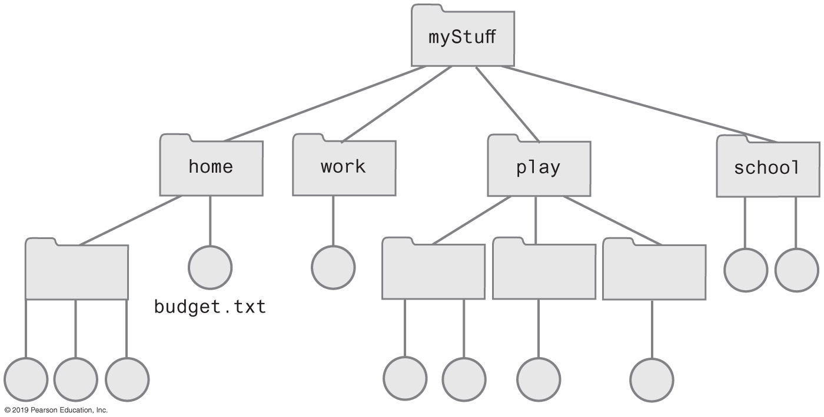
Hierarchical Organizations (2 of 2)
Computer files organized into folders
Notes:
Tree structures

Slide 6
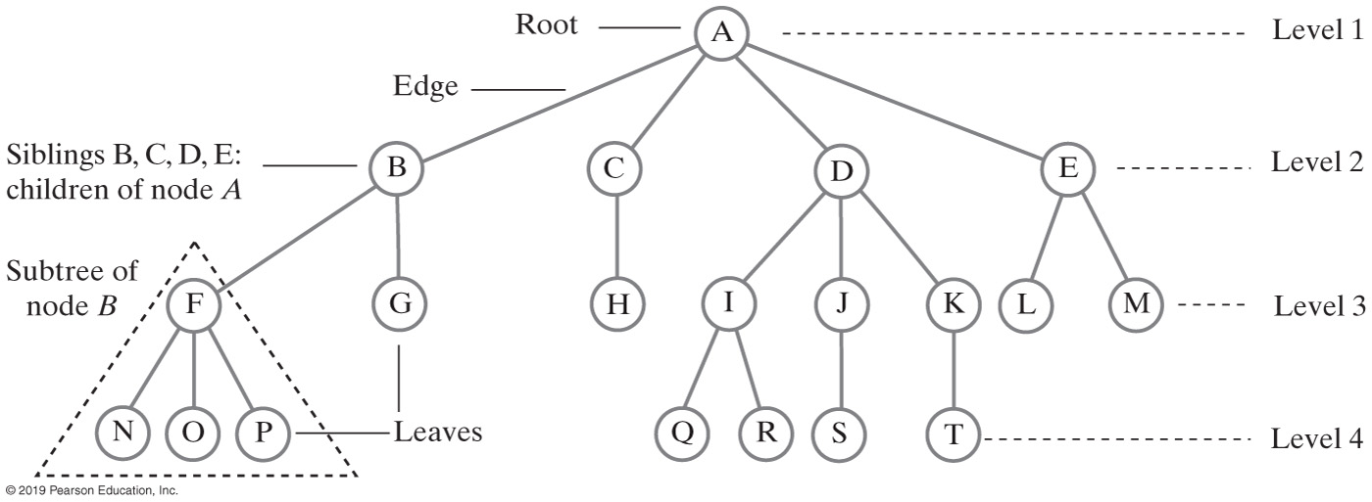
Tree | General Tree
Notes:
Root, leaves & edges
Subtrees
Levels
This is a general tree example
General vs. binary trees

Slide 7
Tree ADT
Root at top
Only node with no parent
Any node and its descendants form a subtree of the original tree
Binary vs. general trees

Slide 8
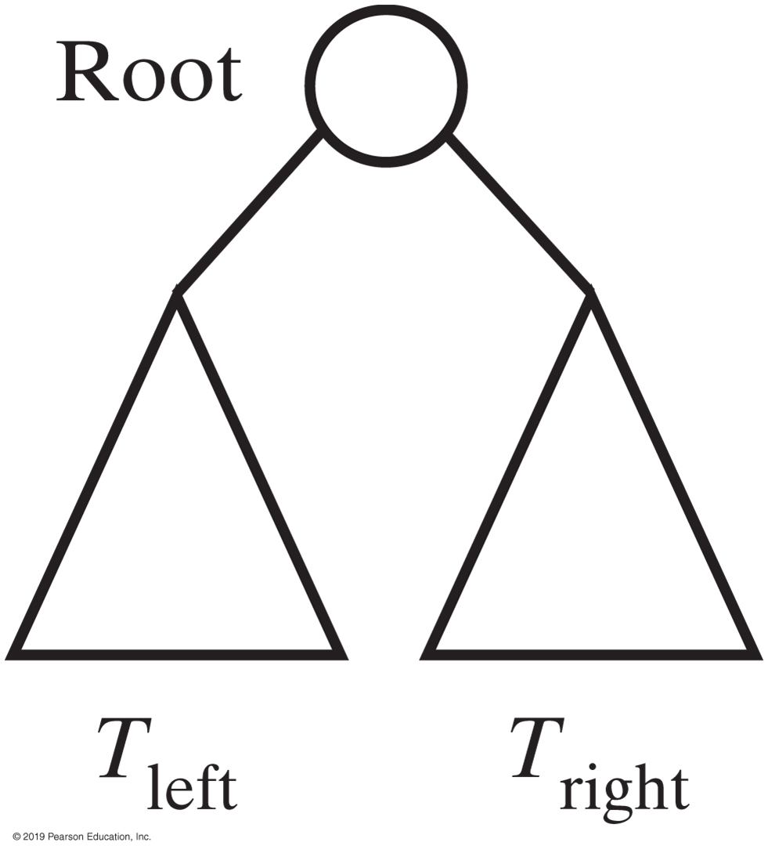
Binary Tree
Notes:
Binary tree: 2 nodes
General vs. binary trees

Slide 9
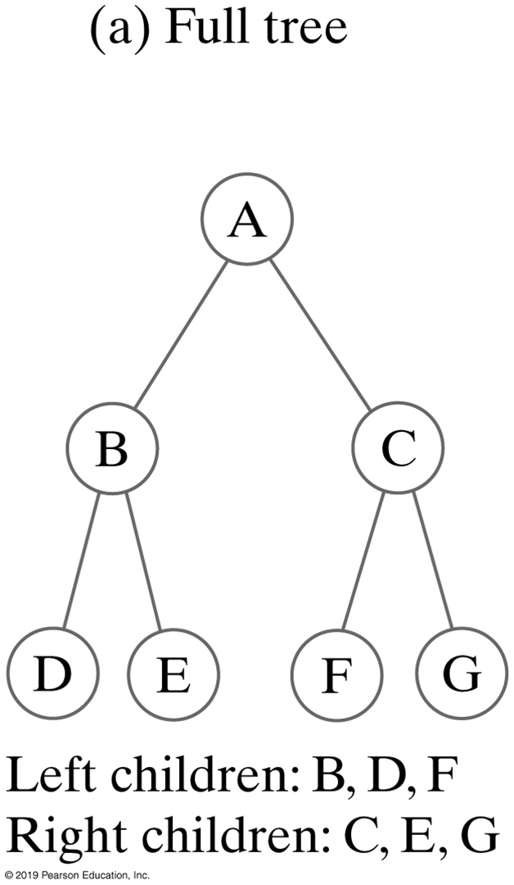
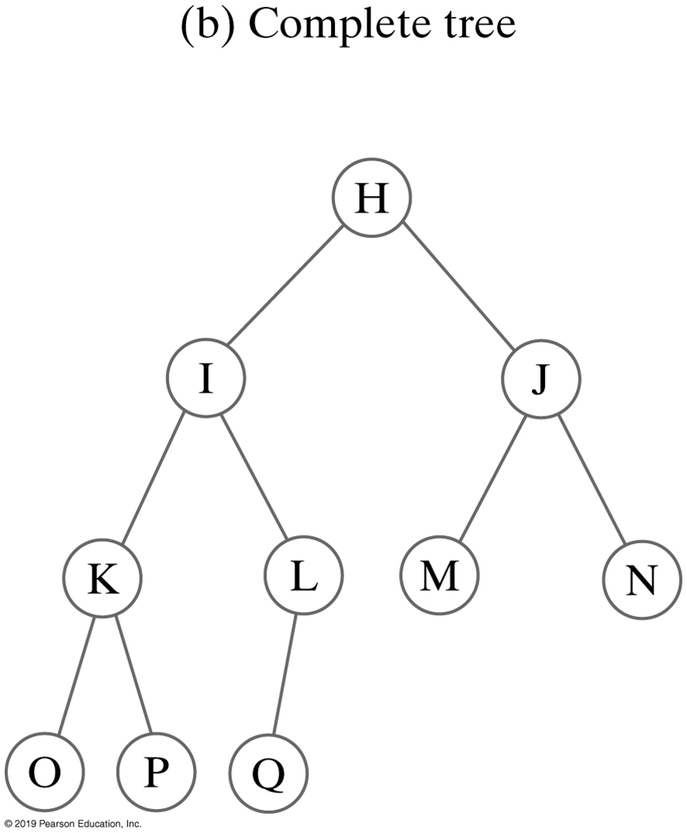
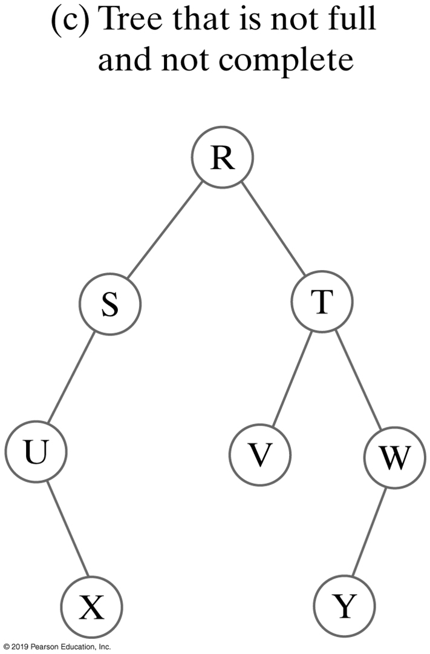
Binary Trees
A complete binary tree is a binary tree in which every level, except possibly the last, is completely filled, and all nodes are as far left as possible
Notes:
Full vs. complete trees

Slide 10
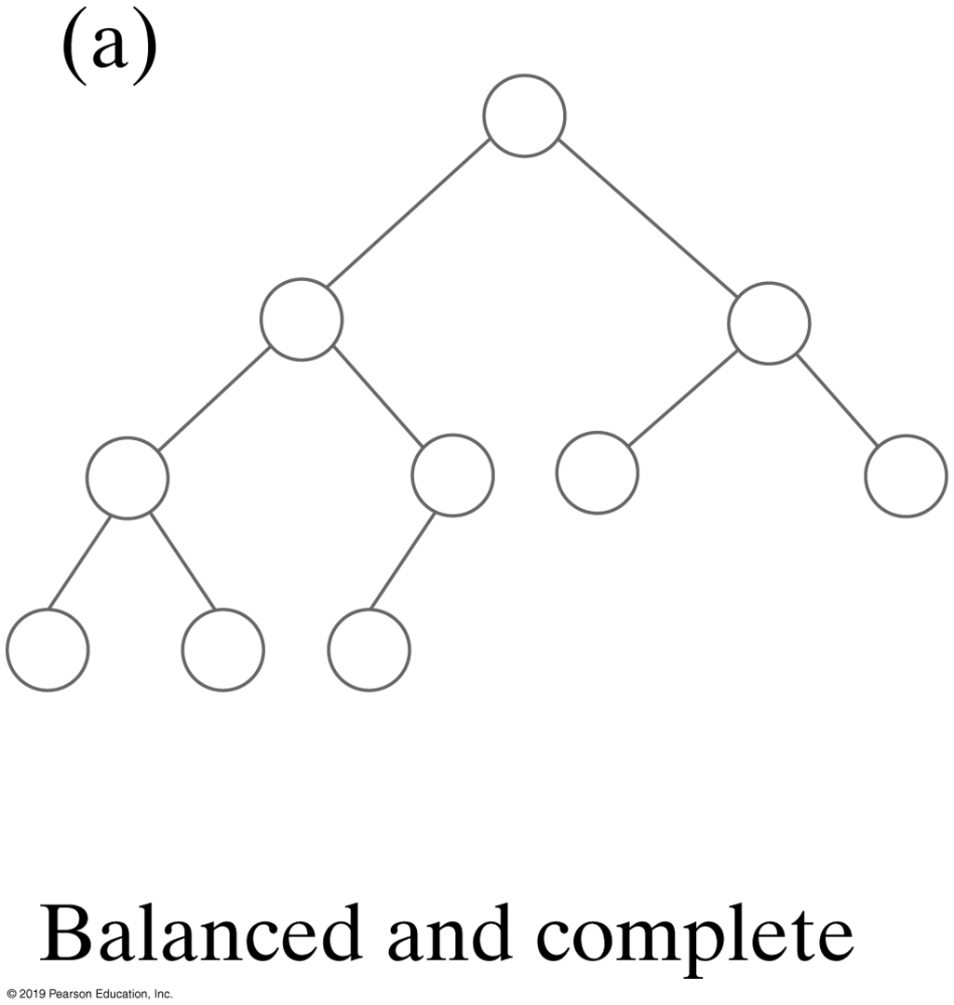
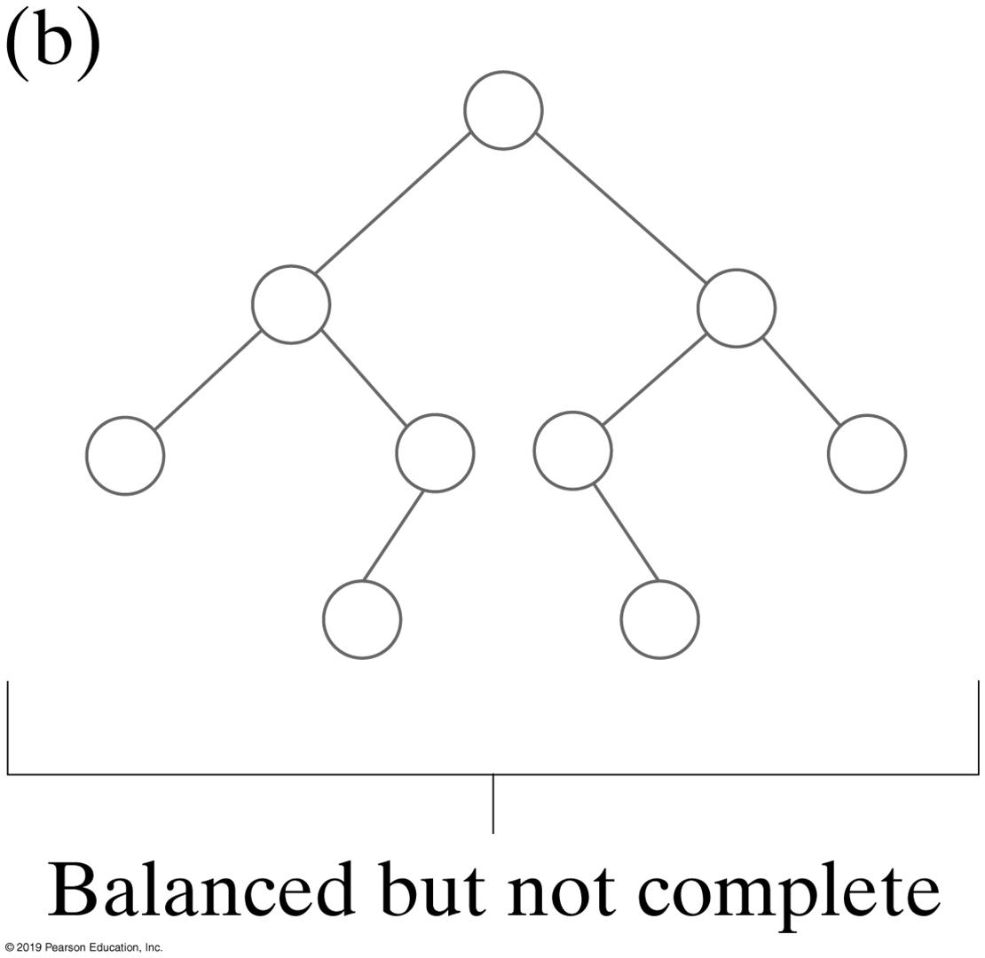
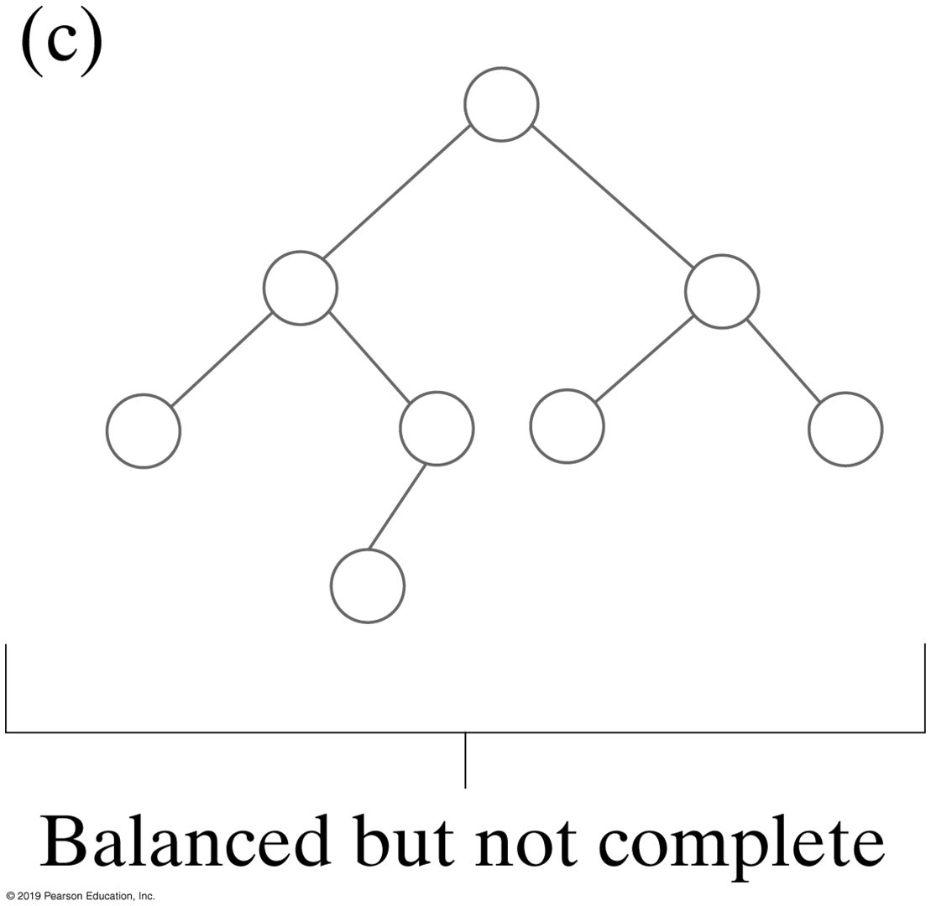
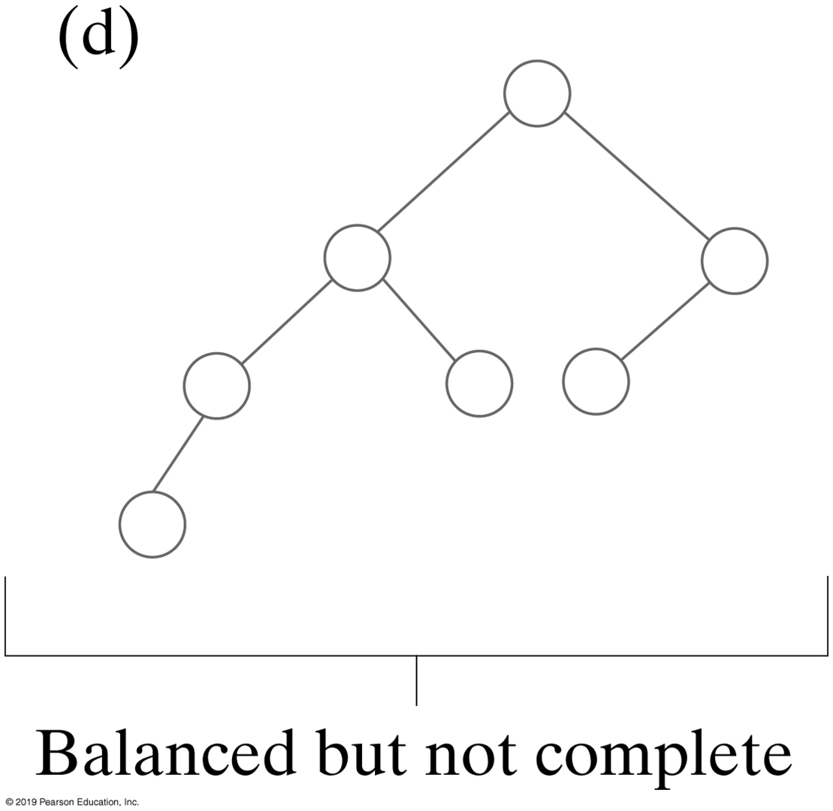
Balanced Binary Trees
Balanced, but not complete
A height-balanced binary tree: a binary tree in which the depth of the two subtrees of every node never differ by more than 1
Notes:
A Balanced tree

Slide 11
Activity 1
Are these trees complete, full, balanced or neither?
(c)
(a)
(b)
(d)
(e)
(f)
Notes:
Complete vs. complete left
Complete, balanced, full
Balanced
What about c – f?

Slide 12
Activity 1: Solution
(c)
(a)
(b)
(d)
(e)
Balanced
Complete, balanced
Complete, full, balanced
neither
Complete, balanced
(f)

Slide 13
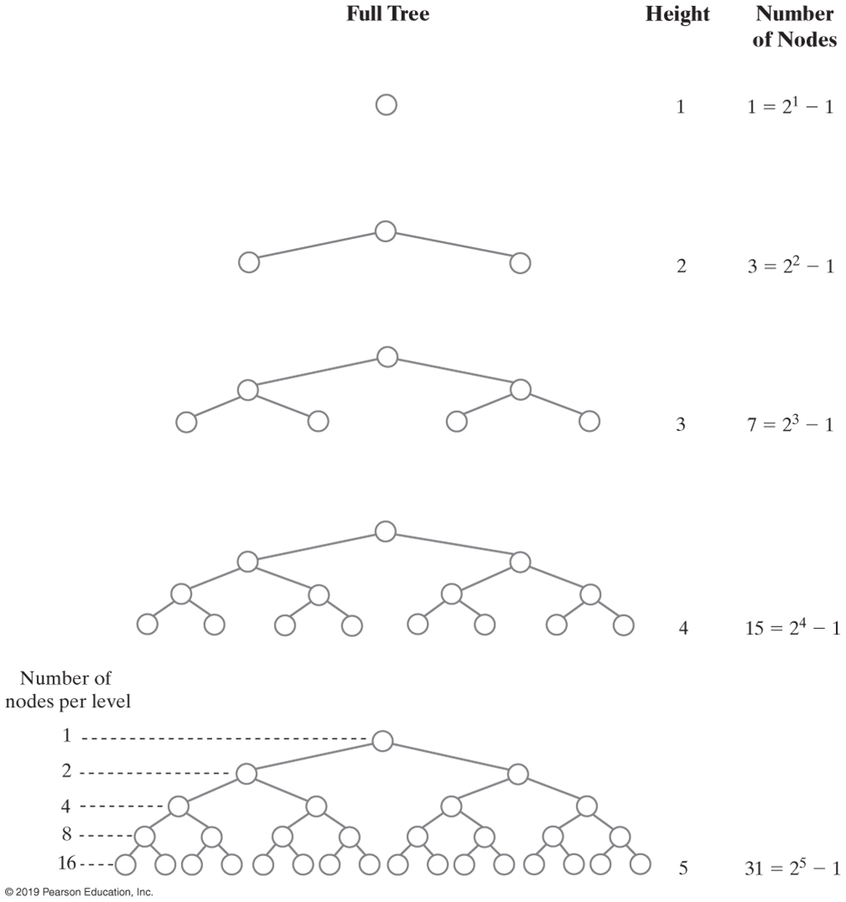
Binary Tree Height (1 of 2)
The number of nodes in a full binary tree as a function of the tree’s height
Notes:
Height of a tree is the number of levels in the tree

Slide 14
Binary Tree Height (2 of 2)
The number of nodes in a full binary tree as a function of the tree’s height
Notes:
Number of nodes per level

Slide 15
Tree Traversals
Traversal
Visit, or process, each data item exactly once
Order in which we visit items is not unique
To visit all the nodes in a binary tree, we must
Visit the root
Visit all the nodes in the root’s left subtree
Visit all the nodes in the root’s right subtree
Use recursion
Traversals of a binary tree are somewhat easy to understand
Traversals for arrays & linked lists
Notes:
Traversals

Slide 16
Binary Tree Traversals
Pre-order traversal
Visit root before we visit root’s subtrees
In-order traversal
Visit root of a binary tree between visiting nodes in root’s subtrees
Post-order traversal
Visit root of a binary tree after visiting nodes in root’s subtrees
Level-order traversal
Begin at root and visit nodes one level at a time

Slide 17
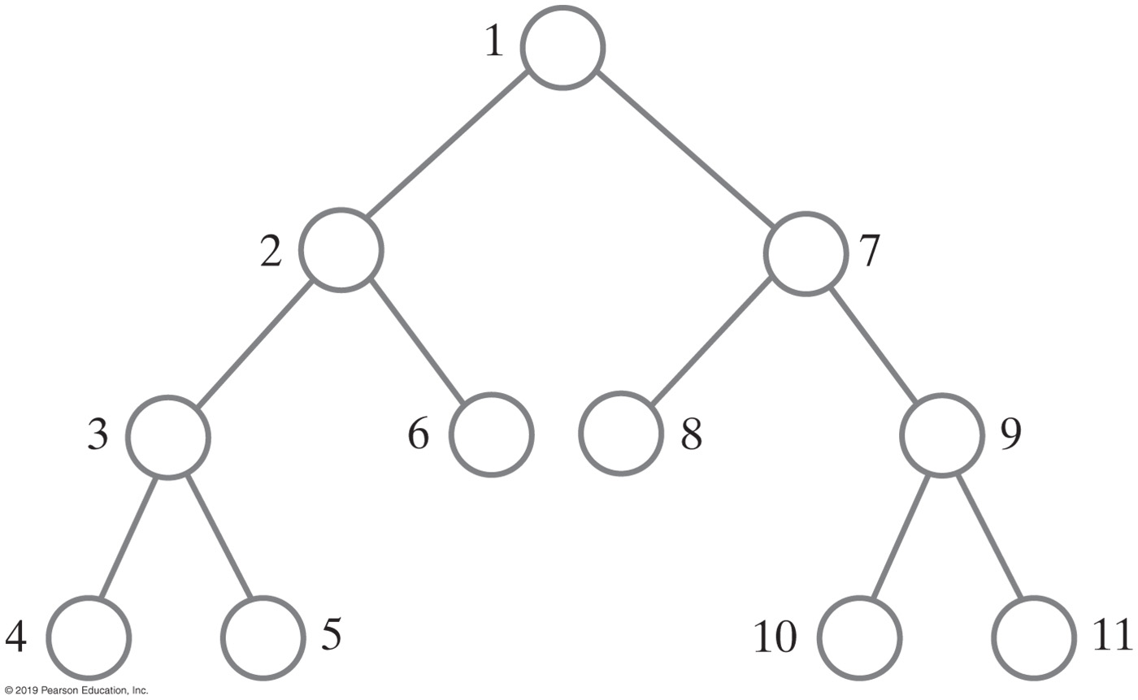
Binary Tree (Pre-order Traversal)

Slide 18
Pre-order Traversal
Visit root before we visit root’s subtrees
Notes:
Subtree of 2 (purple)
Subtree of 3 (red)
Visit left subtree and then right subtree

Slide 19
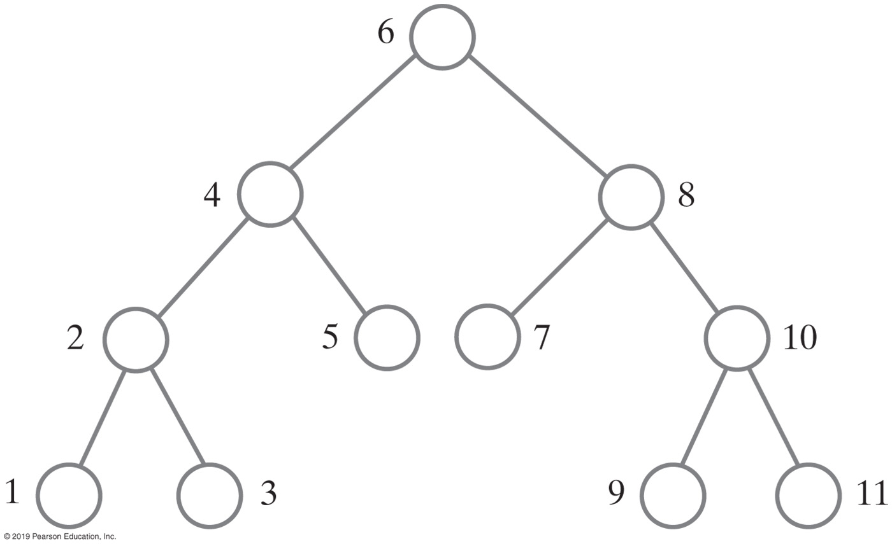
In-order Traversal
Visit root between visiting nodes in root’s subtrees

Slide 20
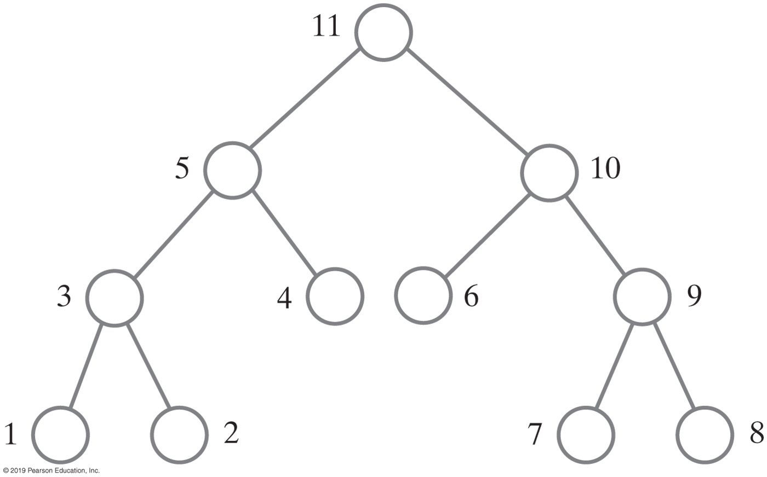
Post-order Traversal
Visit root after visiting nodes in root’s subtrees

Slide 21
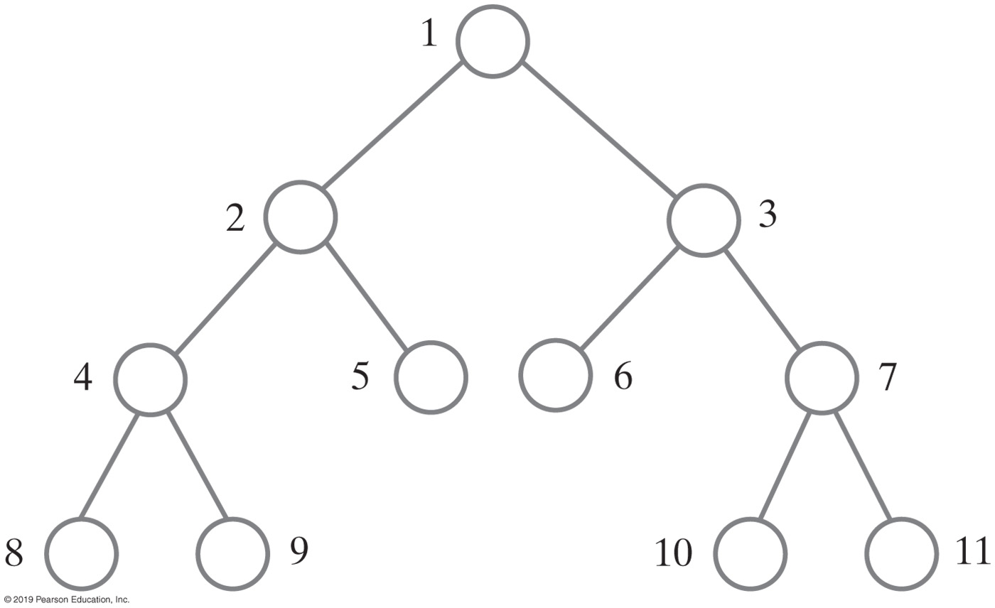
Level-order Traversal
Begin at root and visit nodes one level at a time
Notes:
Same tree, four different traversals

Slide 22
Activity 2
Given the following binary tree:
tree
58
41
75
35
65
85
19
38
60
70
93
1
23
What is the in-order traversal of the tree?
What is the pre-order traversal of the tree?
What is the post-order traversal of the tree?
What is the height of the tree?
What nodes are on level 2?

Slide 23
Activity 2 | Solution
tree
58
41
75
35
65
85
19
38
60
70
93
1
23
In-order traversal
1 19 23 35 38 41 58 60 65 70 75 85 93
Pre-order traversal of the tree?
58 41 35 19 1 23 38 75 65 60 70 85 93
Post-order traversal of the tree?
1 23 19 38 35 41 60 70 65 93 85 75 58
What is the height of the tree? What nodes are on level 2?
height is 5 41, 75

Slide 24
Heaps
Complete binary tree whose nodes contain Comparable objects and are organized as follows:
Each node contains an object no smaller/larger than objects in its descendants
Maxheap: object in node greater than or equal to its descendant objects
Minheap: object in node less than or equal to its descendant objects
Complete binary tree
Binary tree in which every level, except possibly the last, is completely filled, and all nodes are as far left as possible

Slide 25
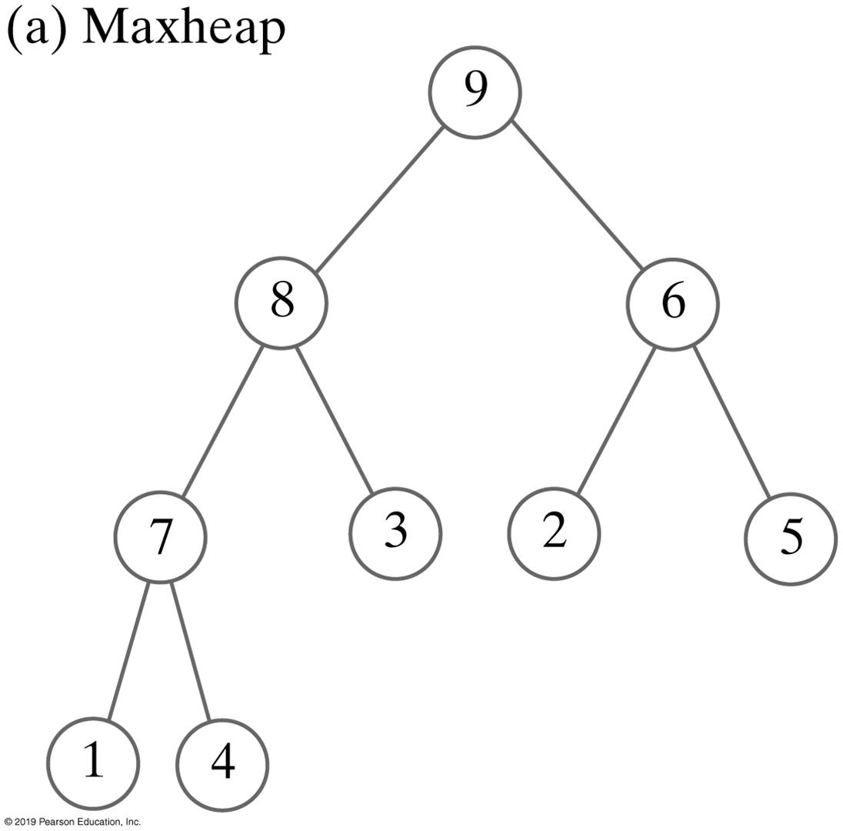

Heaps
Two heaps that contain the same values. Maxheap serves as a priority queue
Notes:
A complete binary tree is a binary tree in which every level, except possibly the last, is completely filled, and all nodes are as far left as possible
Priority queue

Slide 26
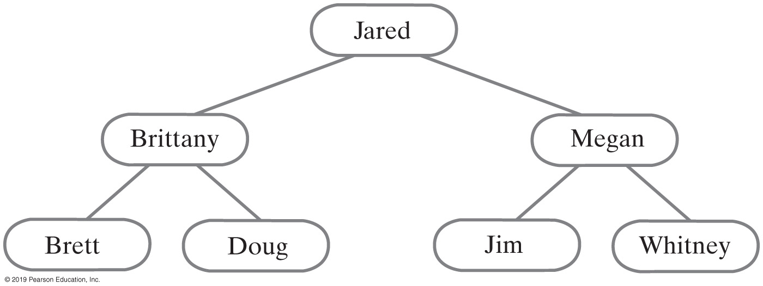
Binary Search Tree (BST)
For each node in a binary search tree
Node’s data is greater than all data in node’s left subtree
Node’s data is less than all data in node’s right subtree
Every node in a binary search tree is the root of a binary search tree
A binary search tree of names
Notes:
Binary vs. BST

Slide 27
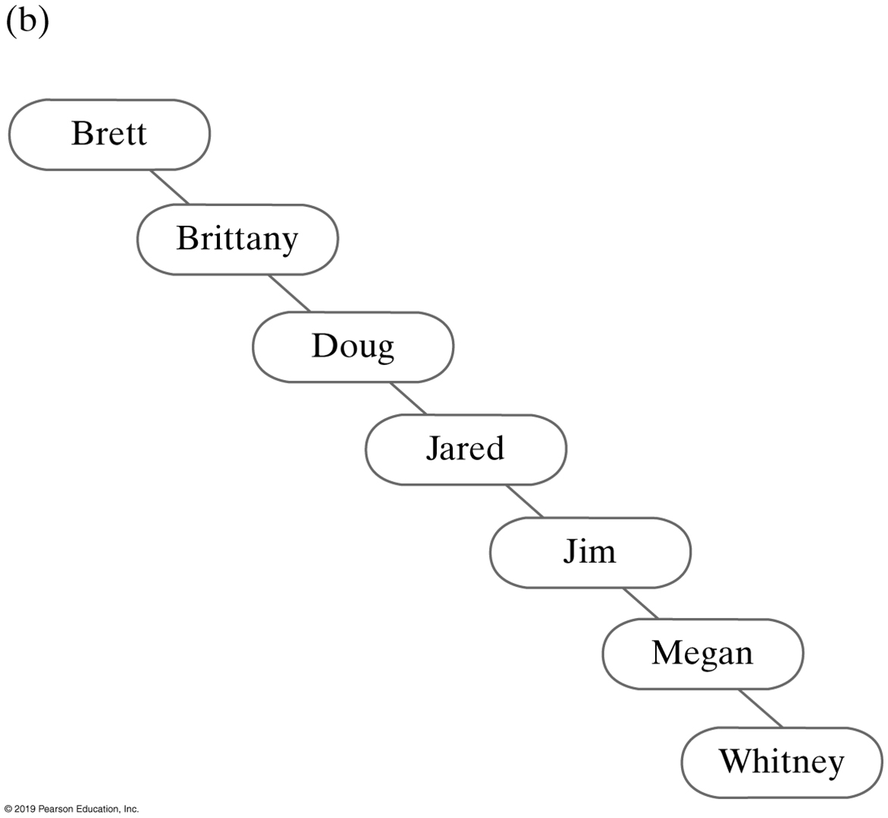
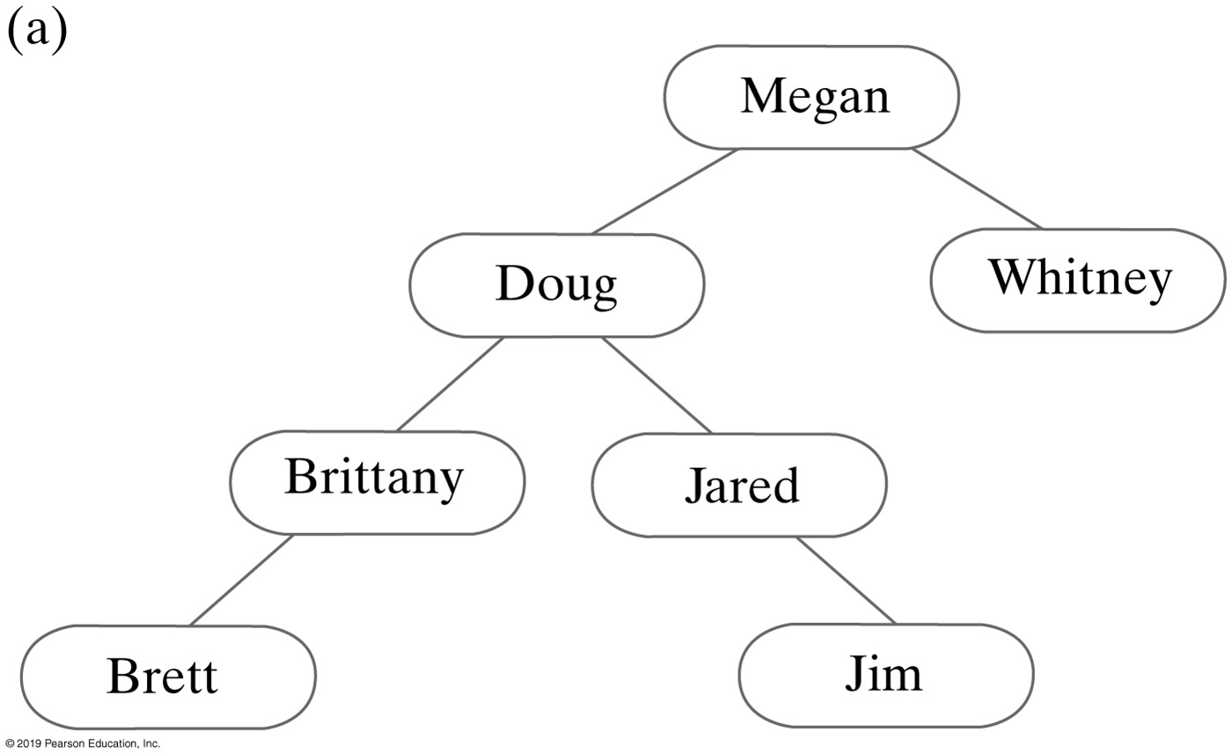
Binary Search Trees
Two binary search trees containing the same data as the tree
Notes:
They contain the same names
Why are they different?
Which one is more efficient?

Slide 28
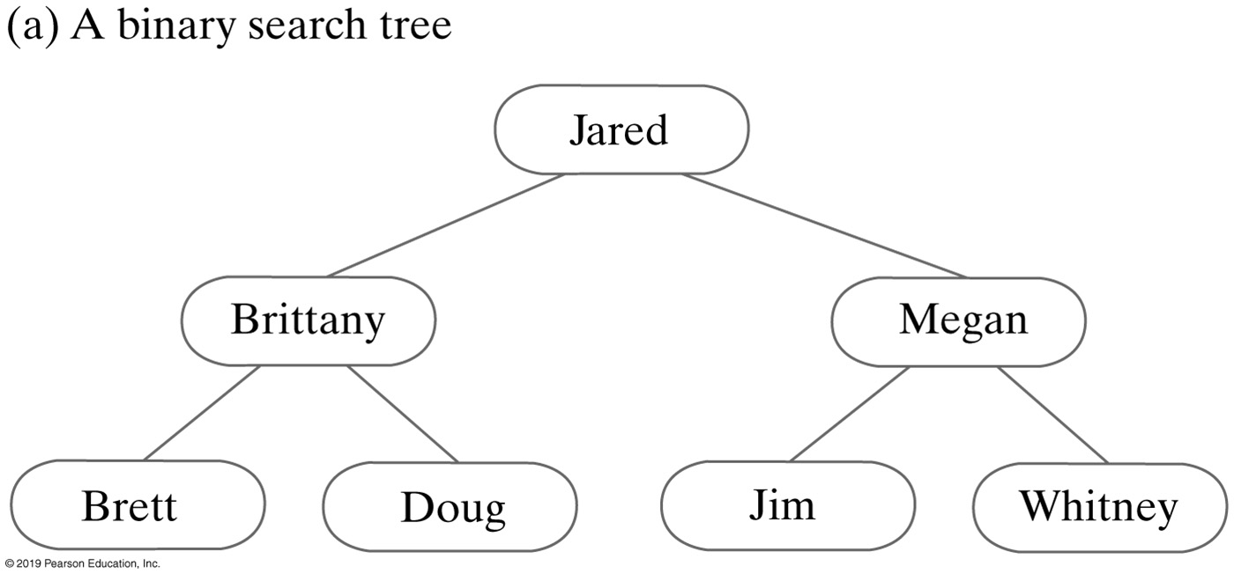
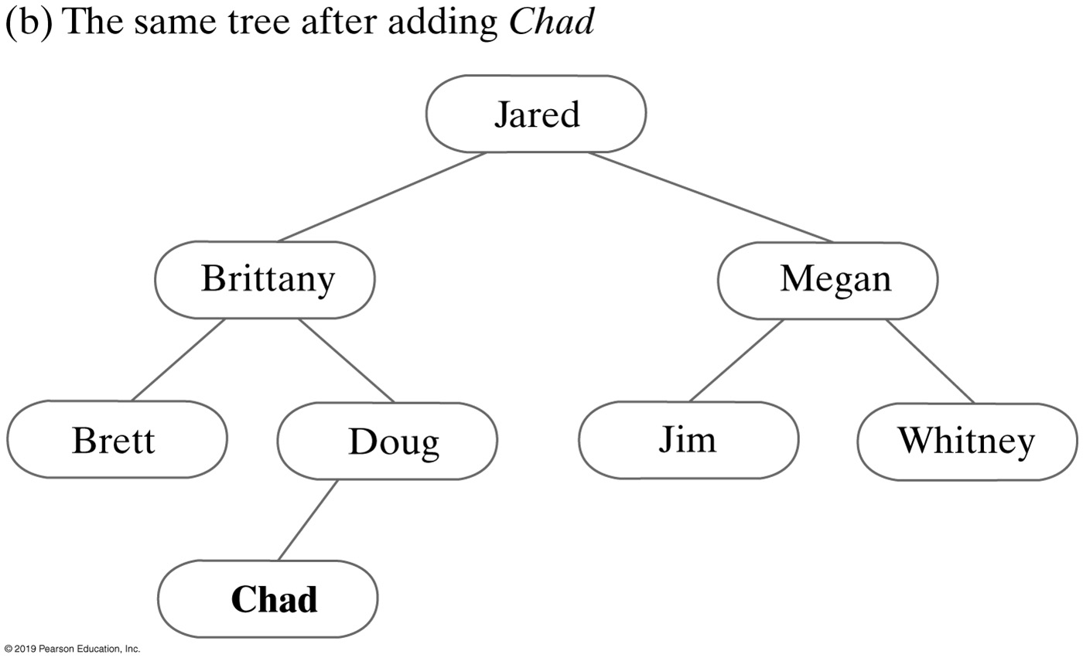
Adding to a Binary Search Tree
A binary search tree before and after adding Chad
Notes:
How does it work?
Can Chad be added anywhere else?
Why not?

Slide 29
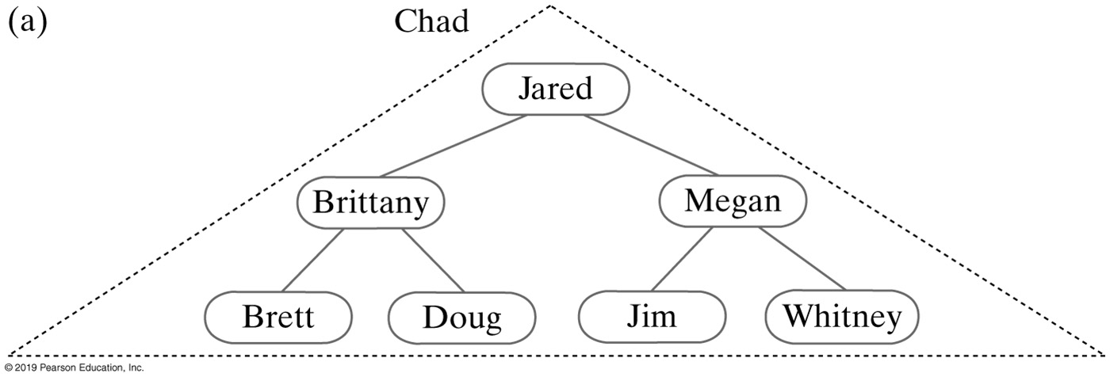
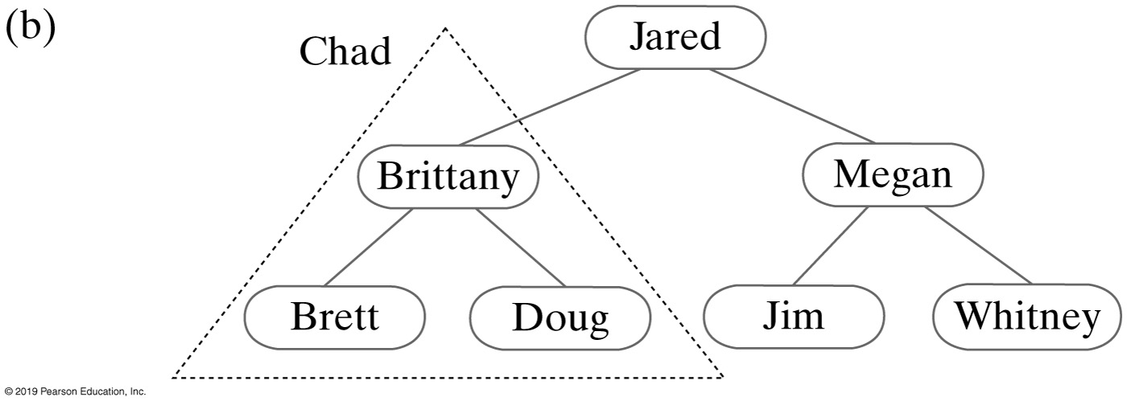
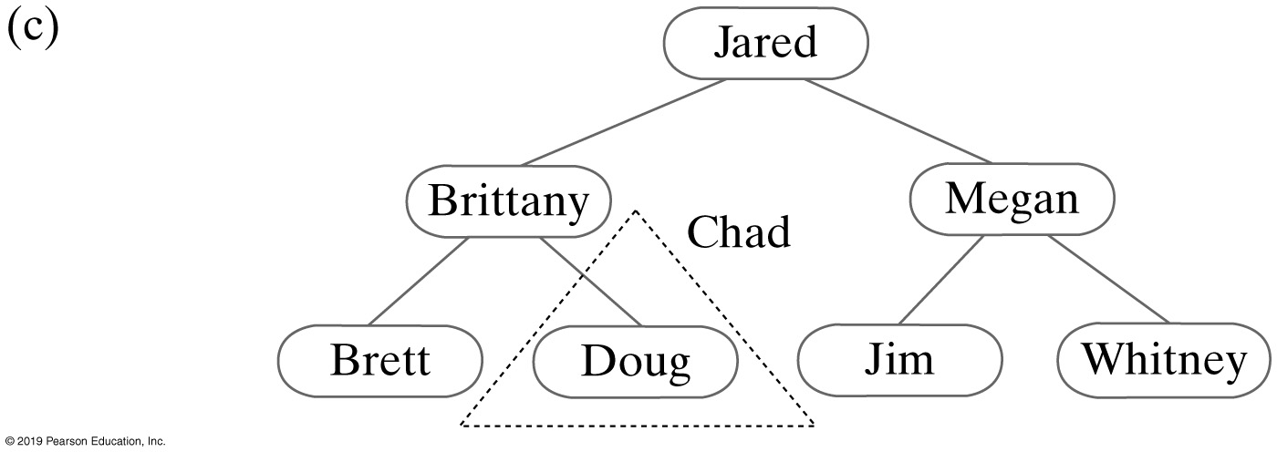
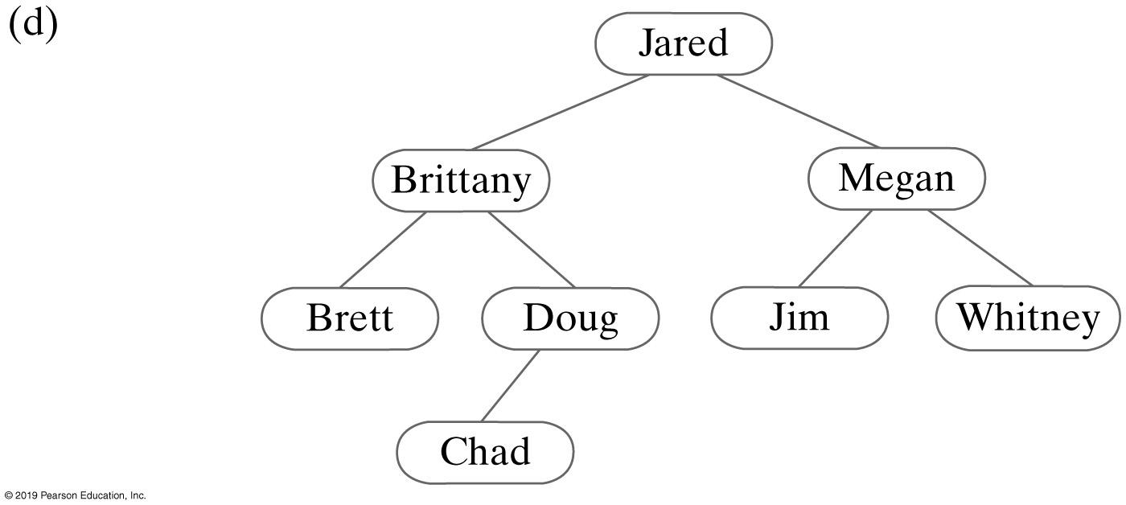
Adding to a Binary Search Tree
Recursively adding Chad to smaller subtrees of a binary search tree

Slide 30
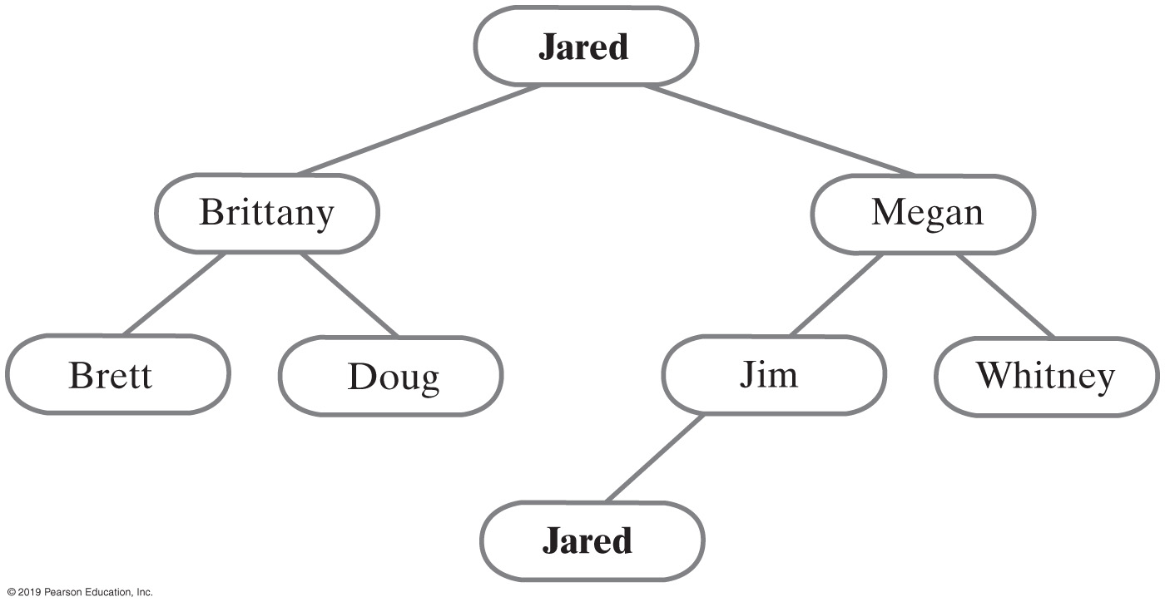
Duplicate Entries
If any entry e has a duplicate entry d, we arbitrarily require that d occur in the right subtree of e’s node
For each node in a binary search tree:
Data in a node is greater than data in node’s left subtree
Data in a node is less than or equal to data in node’s right subtree
A binary search tree with duplicate entries
Notes:
How to handle duplicate entries

Slide 31
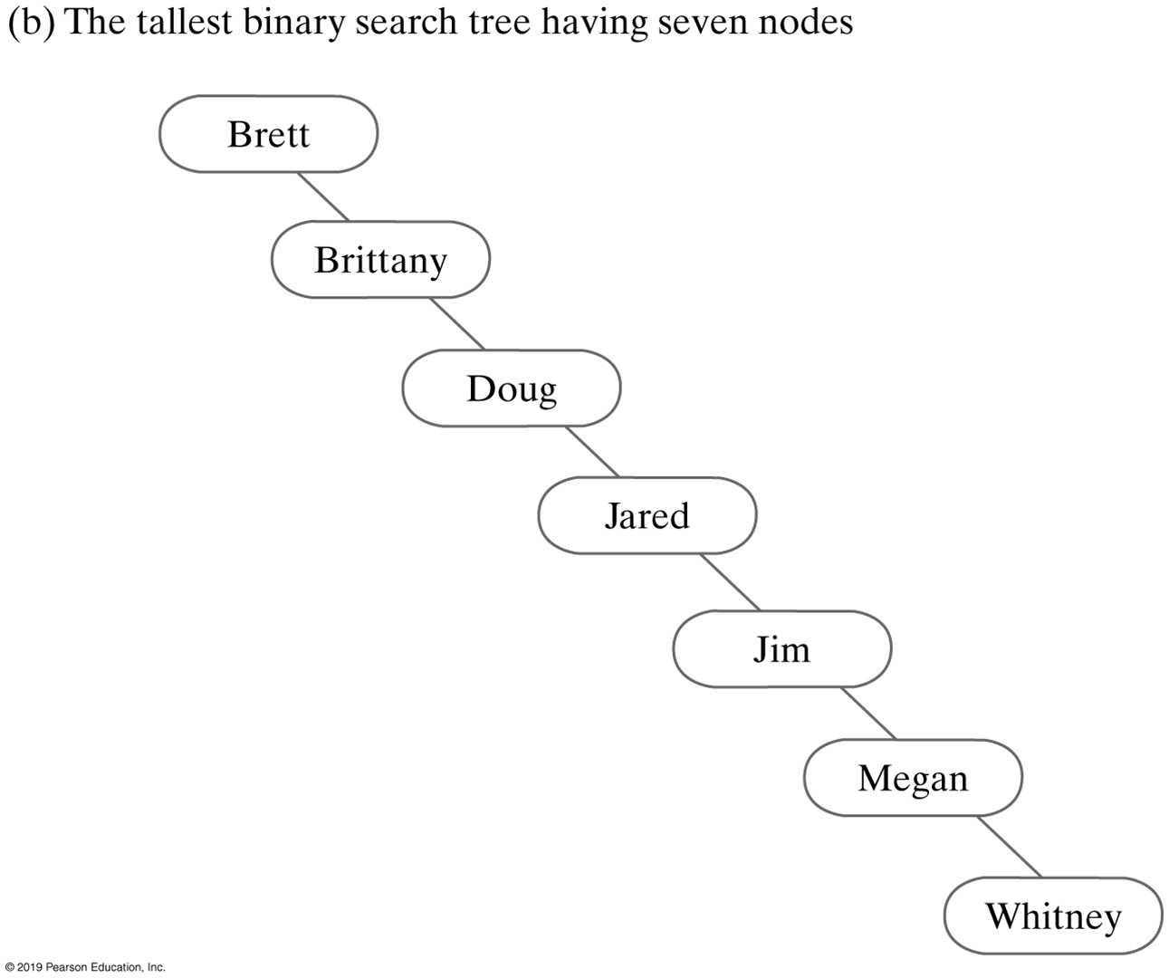
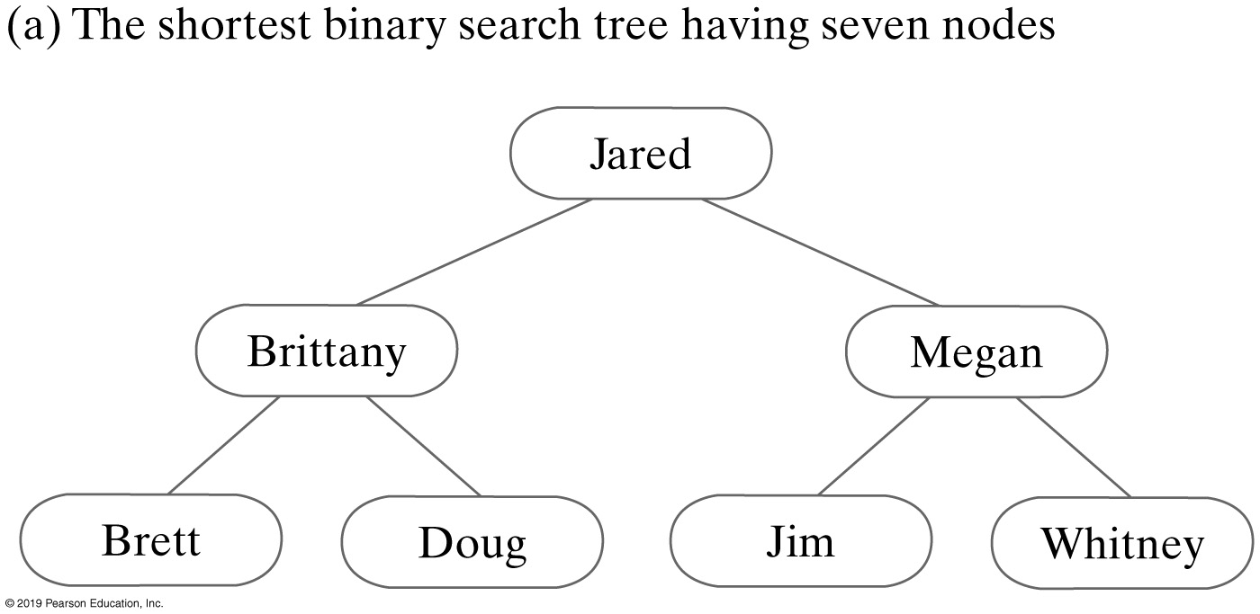
Efficiency of Operations
Operations are O(n)
Operations are O(log n)
Notes:
Two binary search trees that contain the same data

Slide 32
Example
Node insertion order: 50, 40, 47, 63, 55, 43
Insert 50
50
50
50
Insert 40
40
40
Insert 47
47
50
50
50
Insert 63
40
63
40
63
40
63
47
Insert 55
47
55
47
55
Insert 43
43
Let’s add 60 to BST next
32
Notes:
Another activity

Slide 33
Binary Search Tree
Efficiency of a search
Searching a binary search tree of height h is O(h)
To make searching a binary search tree efficient
Tree must be as short as possible
Thinking ahead | Searching and sorting a BST
Searching is merely a traversal
Sorting is done!
Notes:
How do you sort data for –
An array
A Linked list
A binary tree?

Slide 34
Efficiency of Operations
For tree of height h
The operations add, remove, and getEntry are O(h)
If tree of n nodes has height h = n
These operations are O(n)
Shortest tree is full
Results in these operations being O(log n)
Notes:
O(h) vs. O(n)

Slide 35
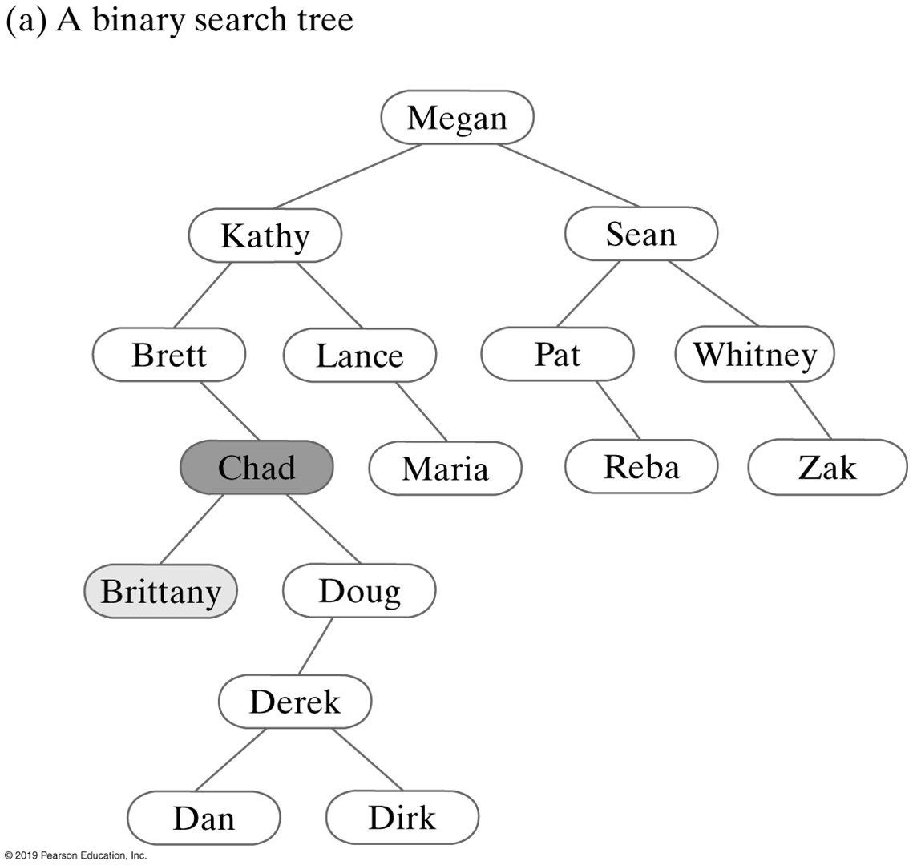
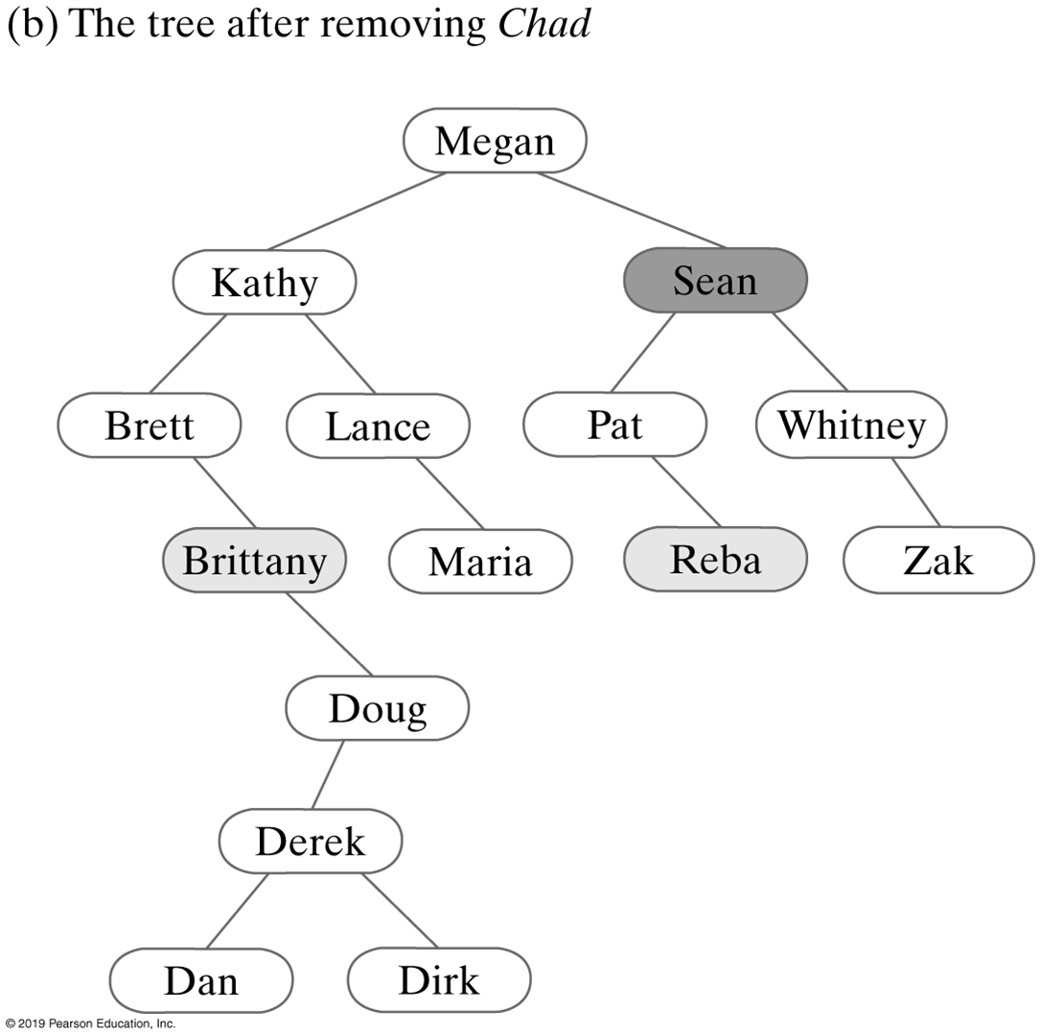
Removals From a Binary Search Tree (1 of 3)

Slide 36
Removals From a Binary Search Tree (1 of 2)

Slide 37
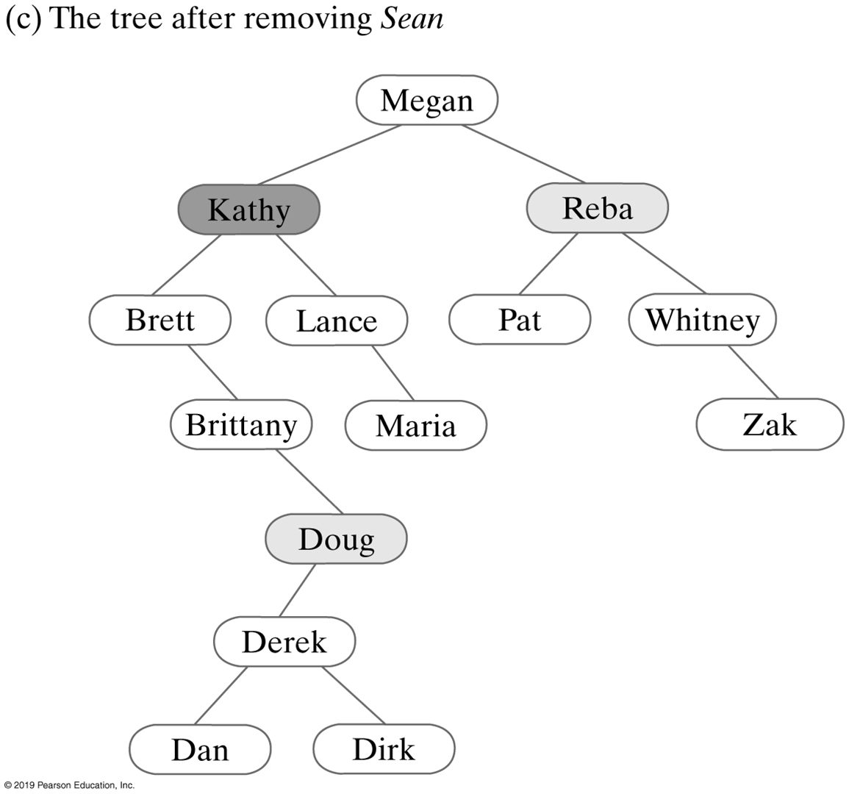
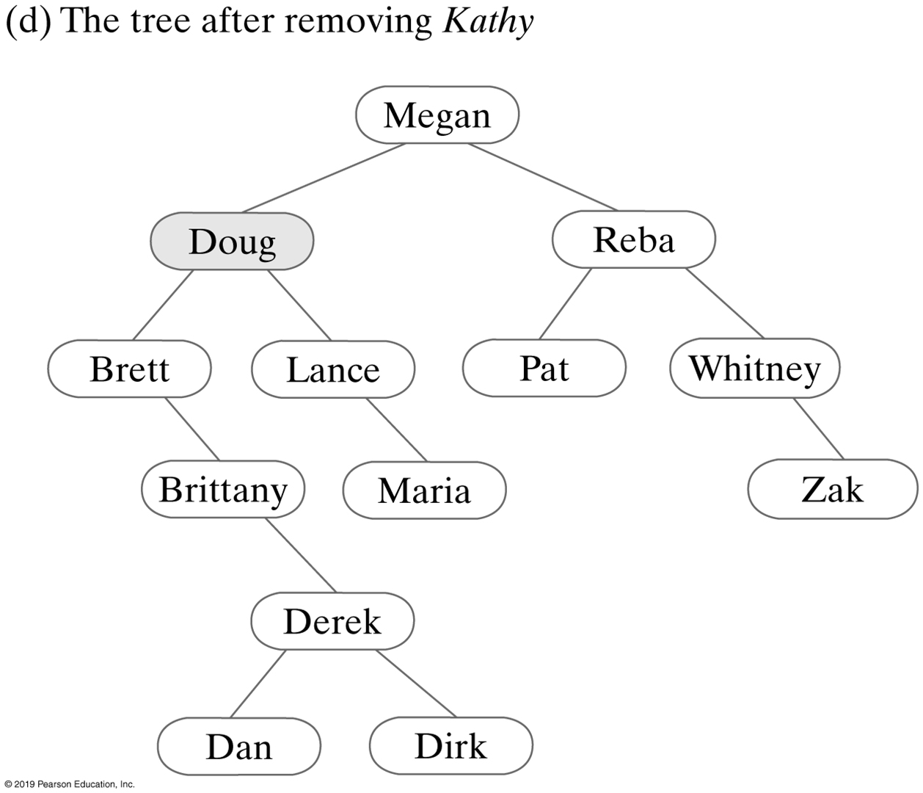
Removals From a Binary Search Tree (2 of 3)

Slide 38
Deleting a node with 2 children
If J was deleted, what would it be replaced with?
J
B
L
A
E
K
S
D
R
Z
Notes:
Delete a leave is easy

Slide 39
Deleting a node with 2 children
If J was deleted, what would it be replaced with?
J
E
Rightmost child
In left subtree
B
L
B
L
S
A
D
K
S
A
E
K
D
R
R
Z
Z
Notes:
Rightmost child in left subtree

Slide 40
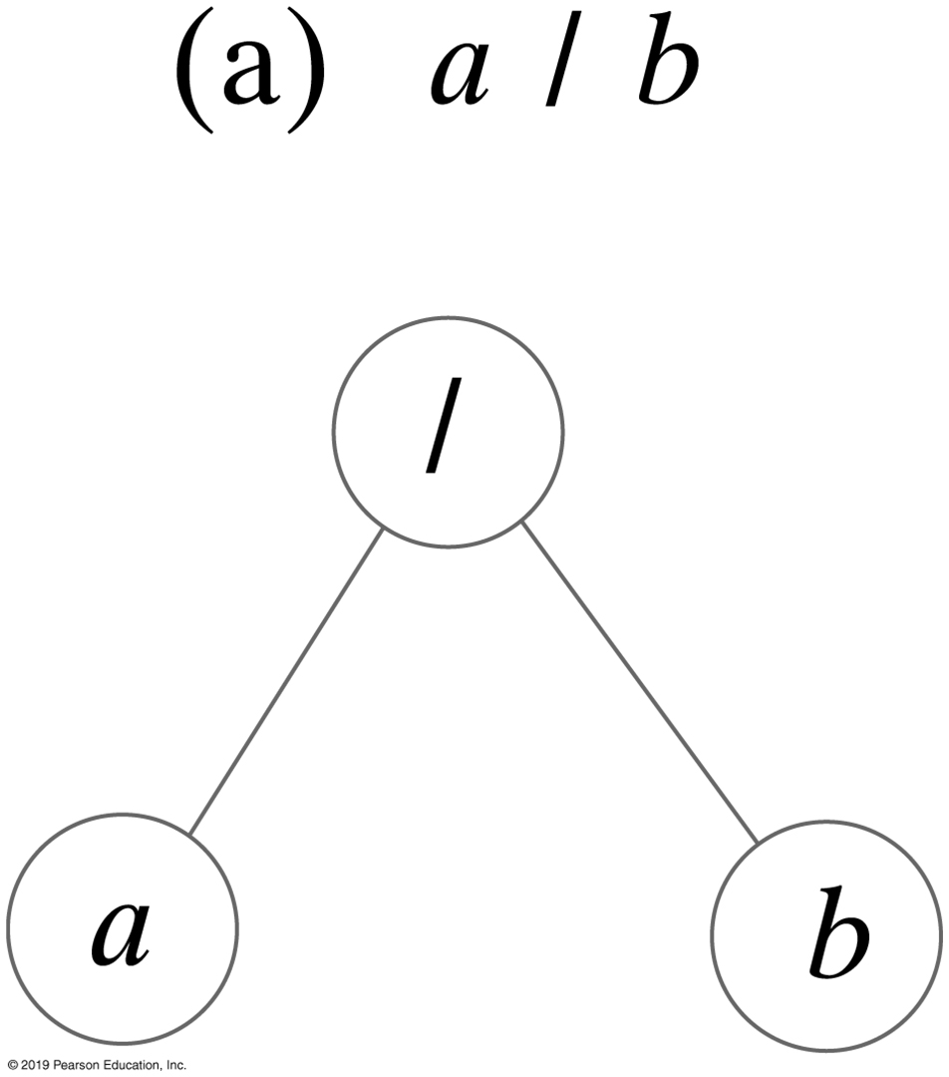
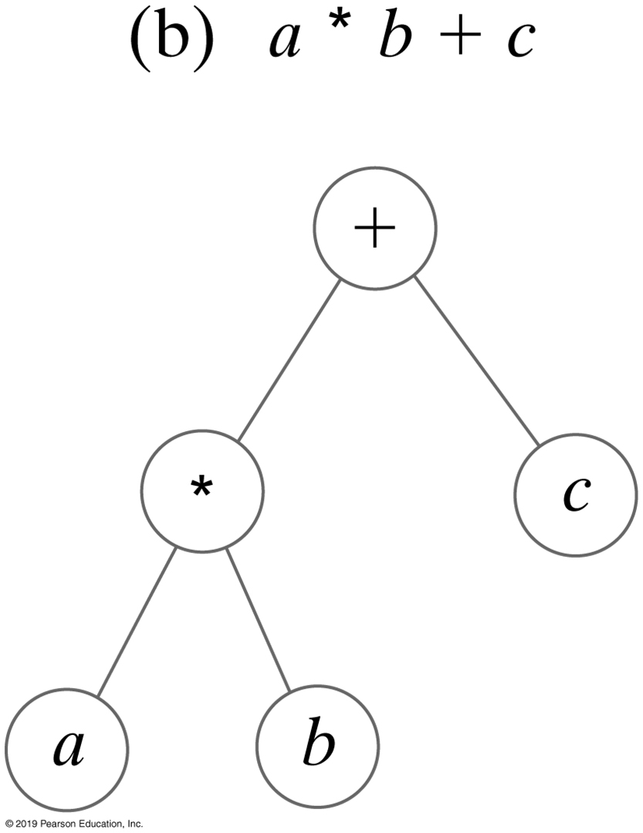
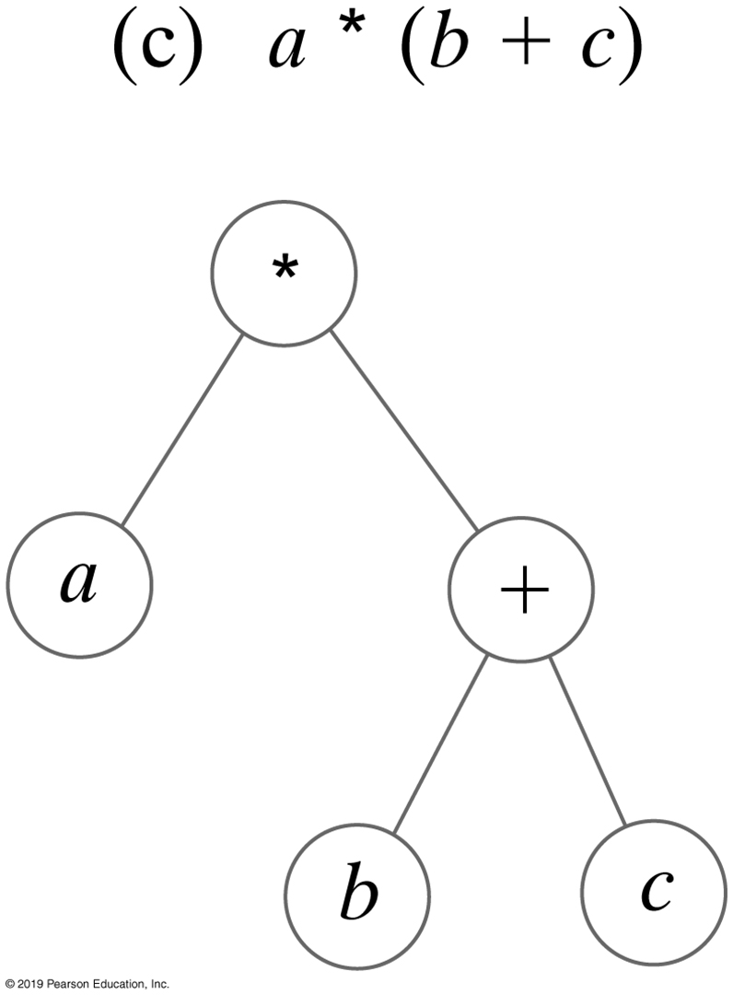
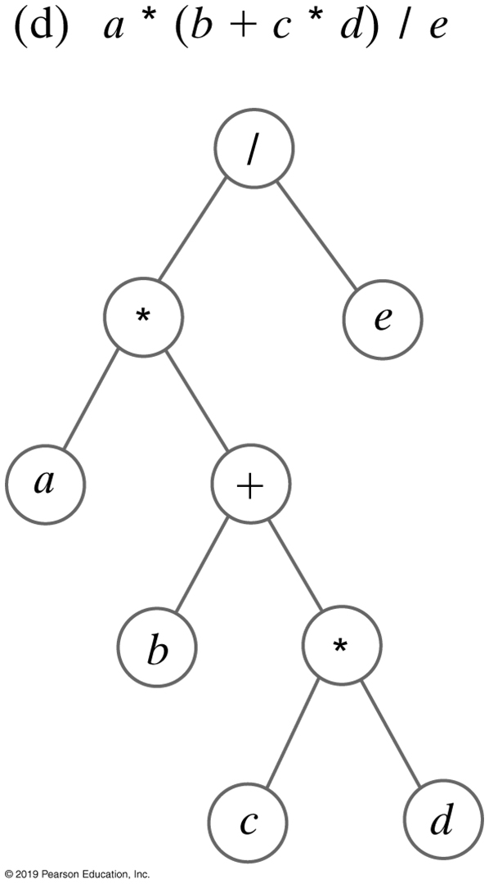
Application | Expression Trees
Expression trees for four algebraic expressions
Notes:
In order traversals

Slide 41
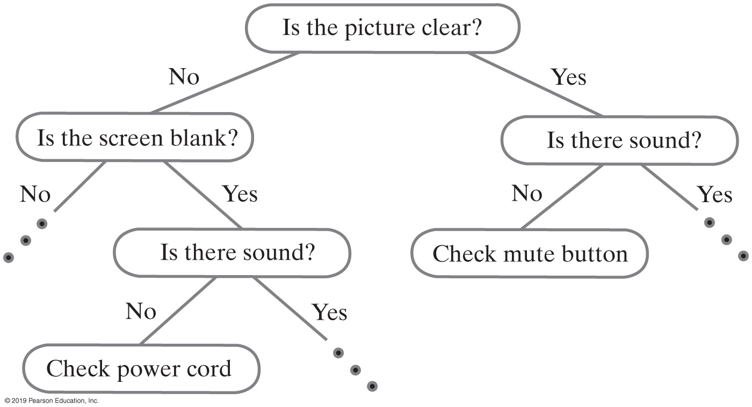
Decision Tree | Expert System
A portion of a binary decision tree

Slide 42
Array-Based Binary Trees
Storing a binary tree in an array
An alternative to the linked representation
Client node references are stored in an array
Relies on a rule to locate a node’s children
42

Slide 43
Example
[0]
[1]
[2]
[3]
[4]
[5]
[6]
[7]
[8]
[9]
[maxElements -1]
G
D
I
B
F
H
J
A
C
E
G
D
I
B
F
H
J
A
C
E
Notes:
Insert nodes into array using level-order traversal

Slide 44
2i + 1, 2i + 2 Rule
For a node whose reference is stored at index i of the array
- its left child’s reference will be stored at index 2i + 1,
- its right child’s reference will be stored at index 2i + 2.
G
D
I
B
F
H
J
A
C
E
[0]
[1]
[2]
[3]
[4]
[5]
[6]
[7]
[8]
[9]
[maxElements -1]
The root node reference is stored at index, i = 0
The “rule” is used to locate a node’ s children
Any binary tree can be stored in an array

Slide 45
What about this Tree?
data
[0]
[1]
[2]
[3]
[4]
[5]
[6]
[7]
[8]
[9]
50
40
60
29
45
70
42
Notes:
Activity

Slide 46
Balanced Tree Using Dummy Values
[0]
[1]
[2]
[3]
[4]
[5]
[6]
[7]
[8]
[9]
50
40
60
29
45
null
70
null
null
42
50
40
60
29
45
70
42
[maxElements -1]

Slide 47
Binary Trees Stored in Arrays
A
data[0]
A’s address
A
data [0]
A’s address
data [1]
B’s address
data [1]
B’s address
B
C
data [2]
C’s address
B
C
data [2]
C’s address
data [3]
null
data [3]
D’s address
E
F
data [4]
E’s address
D
E
F
G
data [4]
E’s address
data [5]
F’s address
data [5]
F’s address
data [6]
null
data [6]
G’s address
data [7]
null
data [7]
null
:
:
data [n-1]
null
data [n-1]
null
data [0]
A’s address
A
data [0]
A’s address
A
data [1]
null
data [1]
B’s address
data [2]
B’s address
B
data [2]
null
B
data [3]
null
data 3]
C’s address
data [4]
null
C
data [4]
null
C
data [5]
null
data [5]
null
data [6]
C’s address null
D
data [6]
null
data [7]
null
data [7]
D’s address
:
:
node[n-1]
null
data [n-1]
null
Notes:
More examples
Take home activities

Slide 48
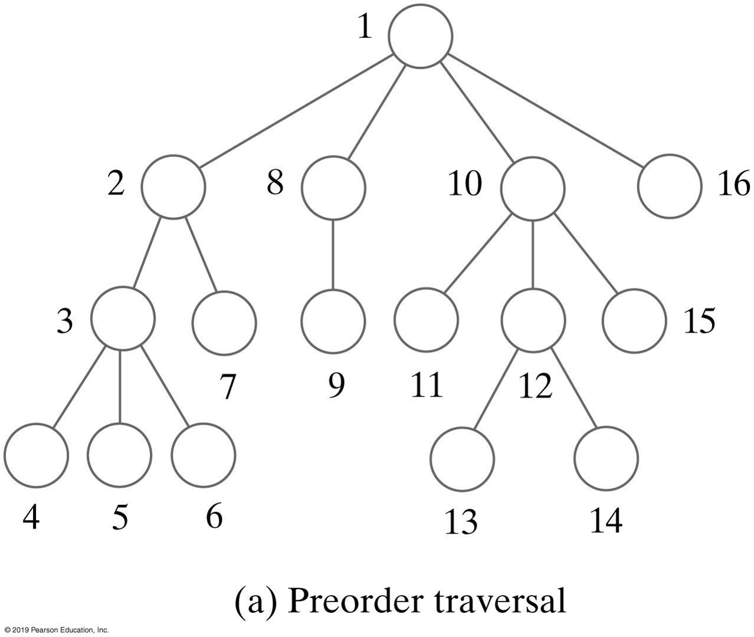
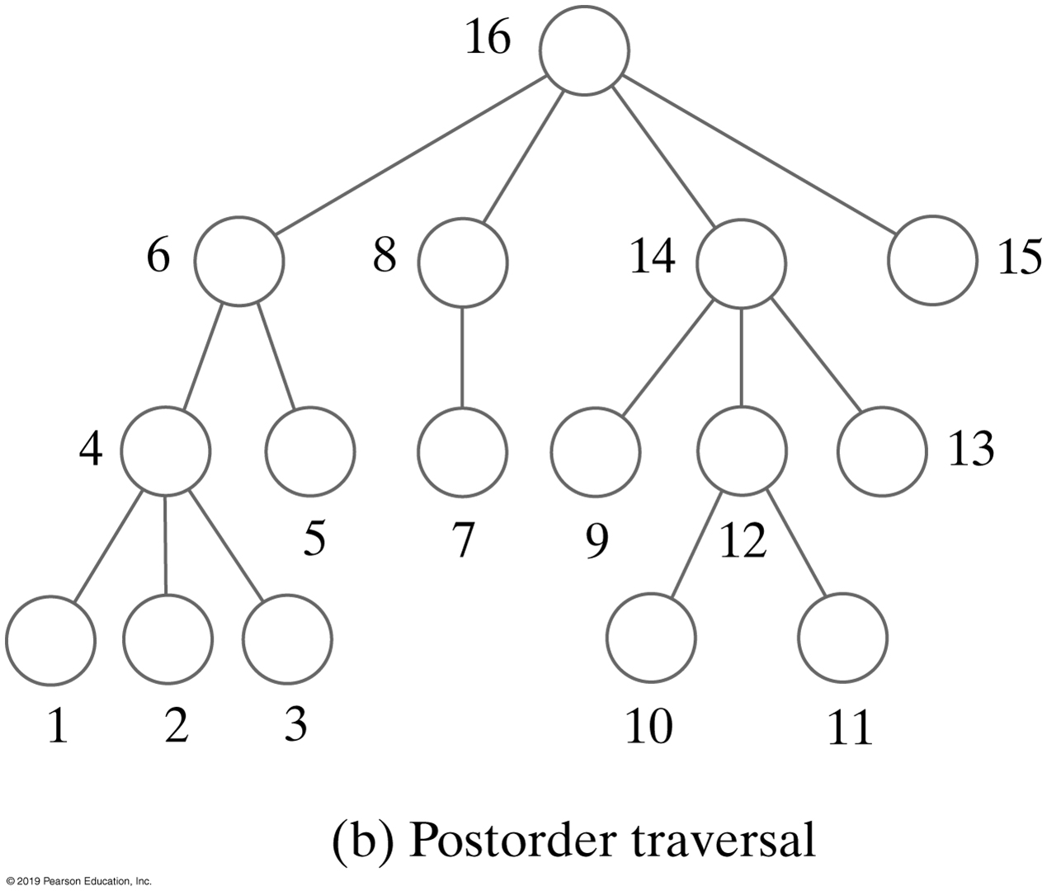
General Tree | Traversals
The visitation order of two traversals of a general tree

Slide 49
General Tree | Traversals
Types of traversals for general tree
Pre-order
Post-order
Level-order
Not suited for general tree traversal
In-order

Slide 50
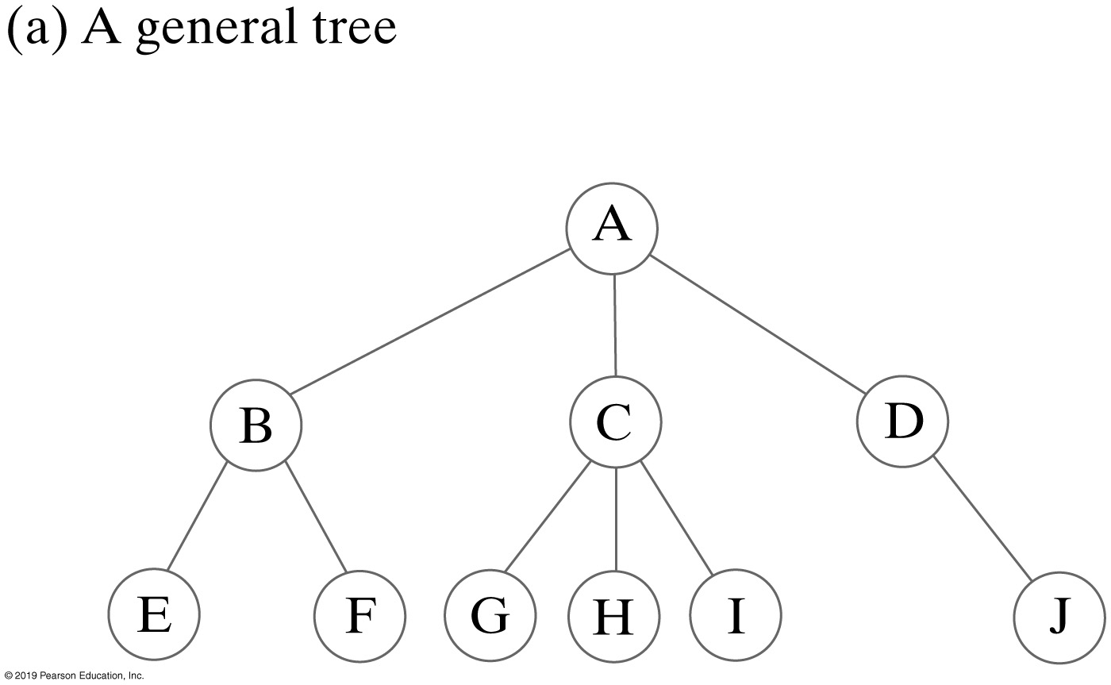
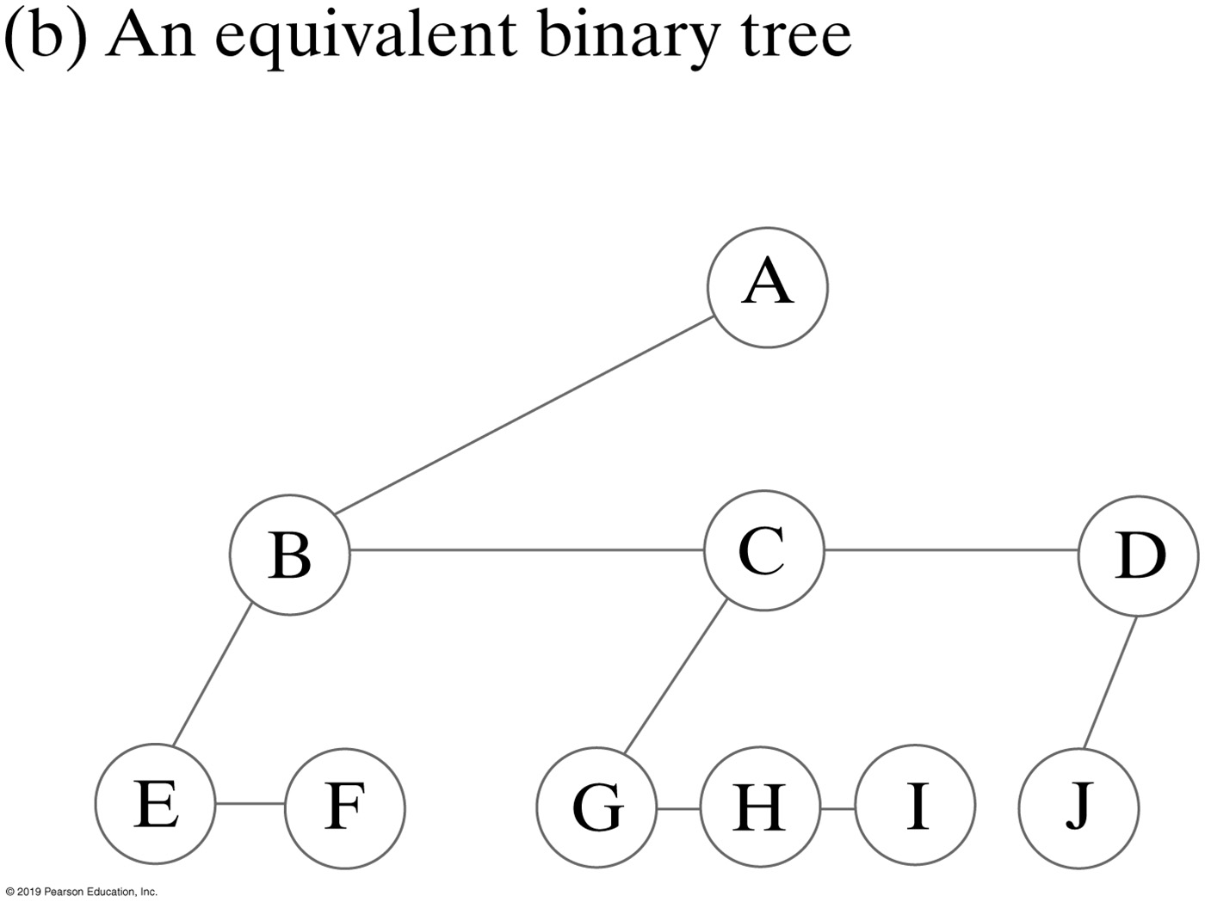
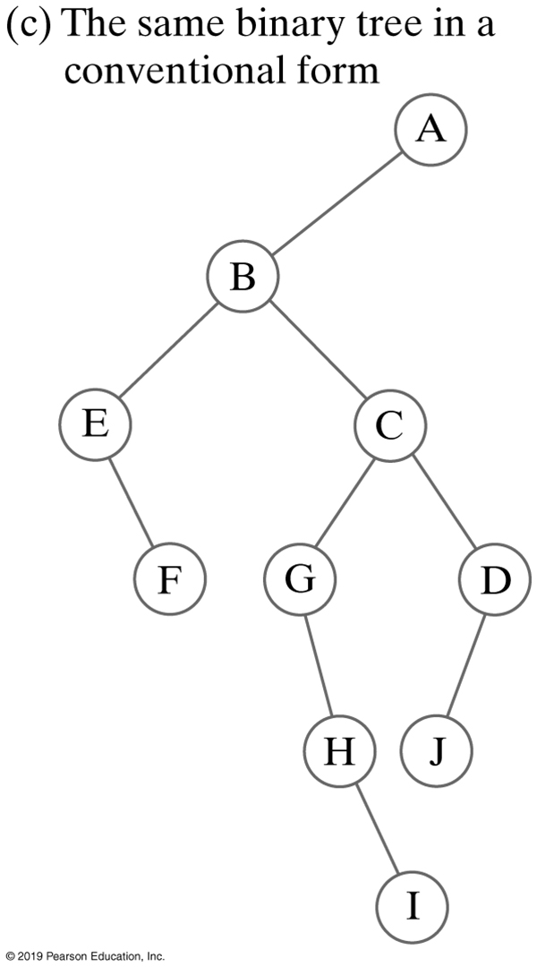
Representing General Trees
A general tree and two views of an equivalent binary tree

Slide 51
More on General Trees
Parse tree
Check syntax of a string for valid algebraic expression
If valid can be expressed as a parse tree
Parse tree must be a general tree
So it can accommodate any expression
Compilers use parse trees
Check syntax, produce code

Slide 52
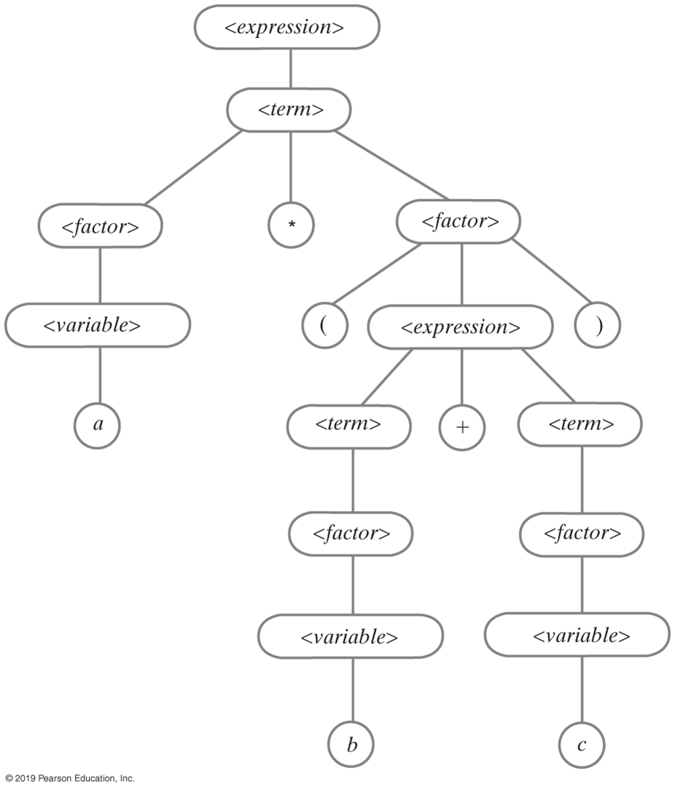
Parse Tree for an Equation
A parse tree for the algebraic expression a * (b + c)

Slide 53
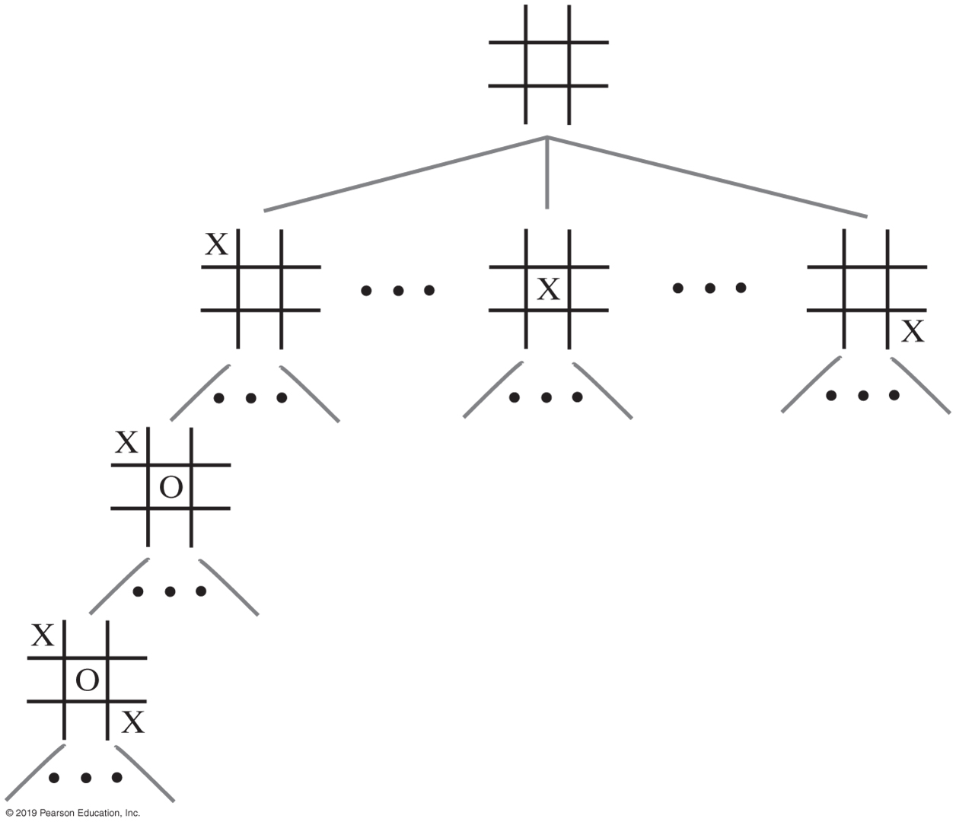
Parse Tree for a Game
A portion of a game tree for tic-tac-toe

Slide 54
Interfaces for All Trees
/** An interface of basic methods for the ADT tree. */
public interface TreeInterface<T>
{
public T getRootData();
public int getHeight();
public int getNumberOfNodes();
public boolean isEmpty();
public void clear();
} // end TreeInterface
Notes:
What vs. How

Slide 55
Traversals
import java.util.Iterator;
/** An interface of iterators for the ADT tree. */
public interface TreeIteratorInterface<T>
{
public Iterator<T> getPreorderIterator();
public Iterator<T> getPostorderIterator();
public Iterator<T> getInorderIterator();
public Iterator<T> getLevelOrderIterator();
} // end TreeIteratorInterface
An interface of traversal methods for a tree

Slide 56
Interface for Binary Trees
package TreePackage;
/* An interface for the ADT binary tree. */
public interface BinaryTreeInterface<T> extends TreeInterface<T>,
TreeIteratorInterface<T>
{
/** Sets the data in the root of this binary tree.
@param rootData The object that is the data for the tree's root.
*/
public void setRootData(T rootData);
/** Sets this binary tree to a new binary tree.
@param rootData The object that is the data for the new tree's root.
@param leftTree The left subtree of the new tree.
@param rightTree The right subtree of the new tree. */
public void setTree(T rootData, BinaryTreeInterface<T> leftTree,
BinaryTreeInterface<T> rightTree);
} // end BinaryTreeInterface

Slide 57
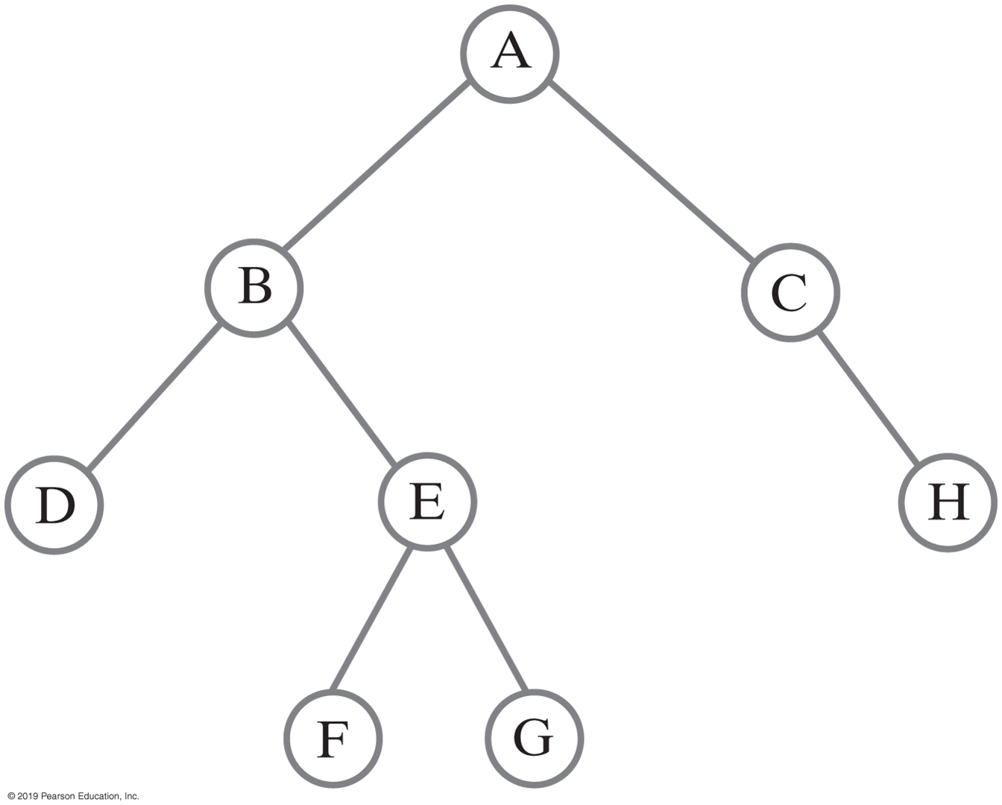
Building a Binary Tree
BinaryTreeInterface<String> dTree = new BinaryTree<>();
dTree.setTree("D", null, null);
BinaryTreeInterface<String> fTree = new BinaryTree<>();
fTree.setTree("F", null, null);
BinaryTreeInterface<String> gTree = new BinaryTree<>();
gTree.setTree("G", null, null);
BinaryTreeInterface<String> hTree = new BinaryTree<>();
hTree.setTree("H", null, null);
BinaryTreeInterface<String> emptyTree = new BinaryTree<>();
// Form larger subtrees
BinaryTreeInterface<String> eTree = new BinaryTree<>();
eTree.setTree("E", fTree, gTree); // Subtree rooted at E
BinaryTreeInterface<String> bTree = new BinaryTree<>();
bTree.setTree("B", dTree, eTree); // Subtree rooted at B
BinaryTreeInterface<String> cTree = new BinaryTree<>();
cTree.setTree("C", emptyTree, hTree); // Subtree rooted at C
BinaryTreeInterface<String> aTree = new BinaryTree<>();
aTree.setTree("A", bTree, cTree); // Desired tree rooted at A
A binary tree whose nodes contain one-letter strings

Slide 58
Building a Binary Tree
// Display root, height, number of nodes
System.out.println("Root of tree contains " + aTree.getRootData());
System.out.println("Height of tree is " + aTree.getHeight());
System.out.println("Tree has " + aTree.getNumberOfNodes() + " nodes");
// Display nodes in preorder
System.out.println("A preorder traversal visits nodes in this order:");
Iterator<String> preorder = aTree.getPreorderIterator();
while (preorder.hasNext())
System.out.print(preorder.next() + " ");
System.out.println();
A binary tree whose nodes contain one-letter strings

